Slide 1
THE EU
IN A NUTSHELL
© EUROPEAN UNION

Slide 2
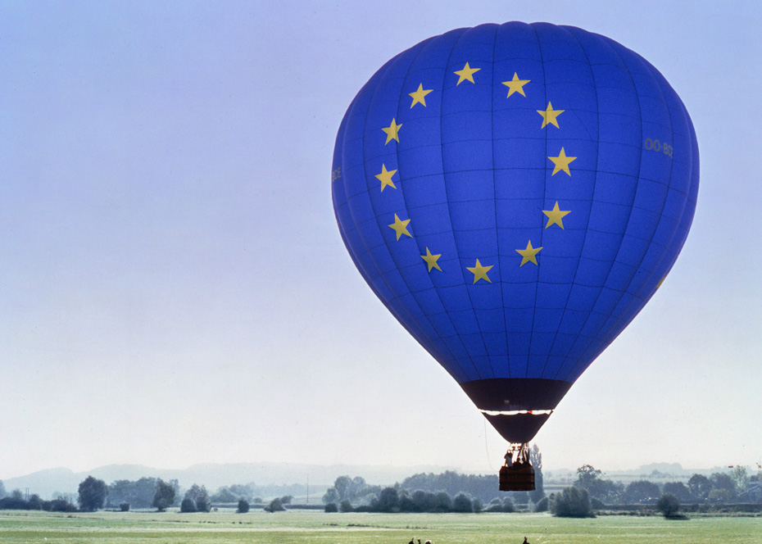
© EUROPEAN UNION
TABLE OF CONTENTS
WHAT IS EUROPE?
THE EUROPEAN PROJECT
WHAT DOES THE EU DO?
HOW DOES THE EU WORK?
HOW CAN I LEARN MORE?
STAY IN TOUCH

Slide 3
WHAT IS EUROPE?

Slide 4
DO YOU FEEL EUROPEAN?
WHAT MAKES YOU FEEL EUROPEAN?
© EUROPEAN UNION

Slide 5
TABLE OF CONTENTS
© PUBLIC DOMAIN
Notes:
Liberale da Verona, “Abduction of Europa”, 1470 ca, oil on poplar wood, Louvres.
The painting depicts the abduction of Europa, a virgin Phoenician princess, by Zeus, who has transformed himself into a white bull to carry the princess away from Crete. According to one of the theories about the origins of the name “Europe”, the continent was named after her.

Slide 6
THE BASICS
EUROPE:
1 of 6 continents
EU:
447 million people
EUROPE:
44
countries
EUROPE:
over 700 million people
EU:
27 countries
WHAT IS EUROPE?
Notes:
What is Europe?
One of the world’s six continents
It is comprised of 44 countries
It has a population of over 700 million people
What is the European Union?
It is a unique economic and political union between 27 European countries, which have decided to join forces to build a better future together
It has a population of approximately 447 million people
The European Union makes it easier for its citizens to live, work and travel in another country in the European Union

Slide 7
EUROPEAN CULTURE
European culture and diversity shaped by:
Ancient Greece and Rome
Reformation and Enlightenment
Parliamentarism and social rights
WHAT IS EUROPE?
© EUROPEAN UNION
Notes:
Key milestones in the creation of modern Europe include:
The founding of Ancient Rome and Ancient Greece, which helped Europe create democracy, government and culture.
The Reformation, in the 16th and 17th centuries, which changed Europe’s approach to religion.
The Enlightenment, an intellectual, political and ideological movement of the 18th century, which stressed the importance of logic and reason, and set out the basic rules for modern science and politics.
The invention of Parliamentarism, which now forms the bedrock of modern European government.
The development of social rights over the 19th and 20th centuries, which now protect the lives and work of European citizens.

Slide 8
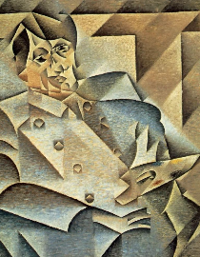
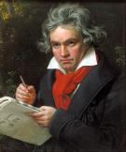
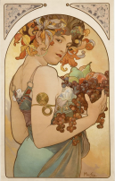
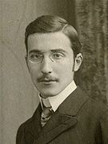
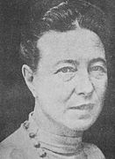
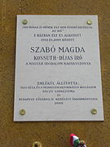
EUROPEAN ARTISTS
Over the centuries, new styles of music, architecture and literature have inspired artists throughout Europe.
For example:
2
© PUBLIC DOMAIN
1
© PUBLIC DOMAIN
Pablo Picasso
Ludwig van Beethoven
Alfons Mucha
Hilma af Klint
Stefan Zweig
Wisława Szymborska
Simone de Beauvoir
Magda Szabó
3
© PUBLIC DOMAIN
4
© PUBLIC DOMAIN
WHAT IS EUROPE?
6
© PUBLIC DOMAIN
5
© PUBLIC DOMAIN
7
© PUBLIC DOMAIN
8
© PUBLIC DOMAIN
Notes:
Pablo Picasso: Spanish artist known for having co-founded (alongside Georges Braque) the Cubism movement. You may know two of his famous works – ‘Guernica’ and ‘Les Demoiselles d’Avignon’.
Ludwig van Beethoven: German composer and pianist known for his symphonies. Beethoven was a crucial figure in the transition between the Classical and Romantic ages of Western music. He composed ‘Ode to Joy’, which later became the European Anthem’.
Alfons Mucha: The Czech painter and illustrator was a member of the Art Nouveau movement. Among his most famous paintings there are ‘Fruit’ (1897) and ‘The Slav Epic’ (1910–1928), which depicts the history of all Slavic peoples.
Hilma af Klint was a Swedish painter. Her abstract paintings, which explored spirituality, cycles of life, spirals, geometry, and colour theory, are considered among the first abstract works known in Western art history.
Stefan Zweig: Austrian novelist, playwright, journalist, and biographer. You may know one of his major works, ‘The Royal Game and Other Stories’ (1941), a collection of five brilliant and creative psychological thrillers.
Wisława Szymborska: Polish poet, essayist and translator, she won the Nobel Prize in Literature in 1996. One of her most famous collections of poems is ‘View with a Grain of Sand’.
Simone de Beauvoir was a French writer, philosopher and essayist. One of her most famous works is her autobiographical novel ‘Mémoires d’une jeune fille rangée’ (1958), where she tells about her early life.
Magda Szabó was a Hungarian novelist, who wrote dramas, essays, studies, memoirs, poetry and children’s literature. Her novel ‘Az ajtó’ (The Door) was published in 1987 and would become one of her most famous works worldwide.
Which other European artists do you know?

Slide 9
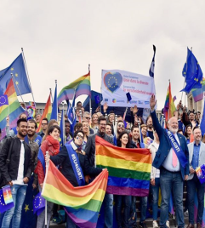
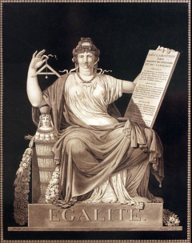
EUROPEAN VALUES
Human dignity
Freedom
Democracy
Equality
Rule of law
Human rights
© EUROPEAN UNION
© PUBLIC DOMAIN
WHAT IS EUROPE?
Notes:
Each EU country has its own culture, language(s) and traditions. Nevertheless they all share the same common values which they must respect if they want to be part of the European Union:
Human dignity
Freedom
Democracy
Equality
Rule of law
Human rights
Which of the European values is the most important for you and why?

Slide 10
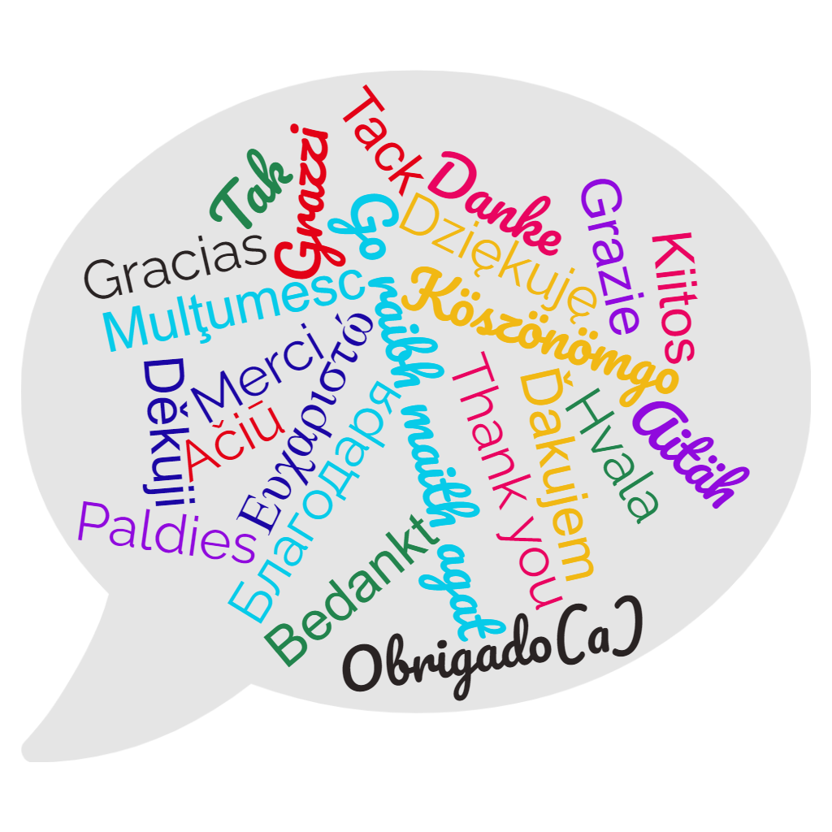
THE 24 EU OFFICIAL LANGUAGES
WHAT IS EUROPE?
Notes:
The European Union has 24 official languages:
Bulgarian
Croatian
Czech
Danish
Dutch
English
Estonian
Finnish
French
German
Greek
Hungarian
Irish
Italian
Latvian
Lithuanian
Maltese
Polish
Portuguese
Romanian
Slovak
Slovene
Spanish
Swedish
Do you speak any other EU language than your mother tongue?
Can you recognise how to say thank you in other EU languages?

Slide 11
EU LANGUAGE FAMILIES
24 EU OFFICIAL LANGUAGES
Slavic: Bulgarian, Czech, Croatian, Polish, Slovak and Slovene
Germanic: Danish, German, English, Dutch and Swedish
Romance: Spanish, French, Italian, Portuguese and Romanian
Other: Estonian and Finnish, Greek, Irish, Lithuanian and Latvian, Hungarian, Maltese
WHAT IS EUROPE?
Notes:
The European Union has 24 official languages from different language families:
Germanic languages: Danish, German, English, Dutch and Swedish.
Romance languages: Spanish, French, Italian, Portuguese and Romanian.
Slavic languages: Bulgarian, Czech, Croatian, Polish, Slovak and Slovene.
The EU languages that are not part of one of these three families are:
Estonian and Finnish
Greek
Irish
Lithuanian and Latvian
Hungarian
Maltese

Slide 12
THE EUROPEAN PROJECT

Slide 13
WHICH COUNTRIES CREATED THE EU AND WHY?
© EUROPEAN UNION
Notes:
The European Union was created to end the frequent and bloody wars between neighbours, which culminated in the Second World War.
As of 1950, the European Coal and Steel Community began to unite European countries economically and politically in order to secure lasting peace.
The countries that founded the European Union are:
Belgium
Germany
France
Italy
Luxembourg
The Netherlands

Slide 14
FROM WAR TO PEACE
© PUBLIC DOMAIN
1914
1918
1939
1945
© PUBLIC DOMAIN
© PUBLIC DOMAIN
© PUBLIC DOMAIN
THE EUROPEAN PROJECT
Notes:
European nations have not always lived together in peace. Many wars have been fought throughout the centuries.
Two world wars took place in the 20th century:
1914-1918 World War I
1939-1945 World War II

Slide 15
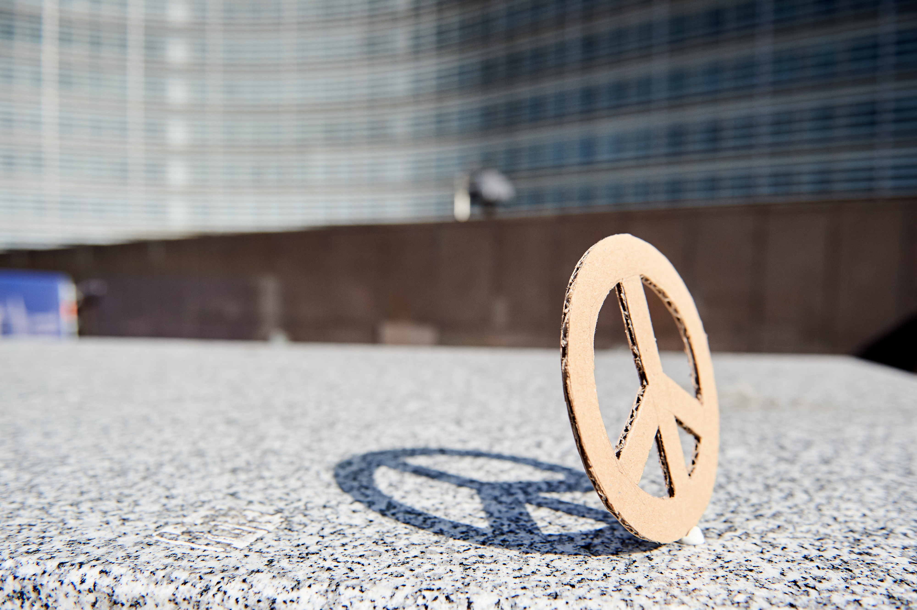
FROM WAR TO PEACE
© EUROPEAN UNION
Peace was one of the aims that led to the creation of the European Union
The EU received the Nobel Peace Prize in 2012
THE EUROPEAN PROJECT
Notes:
Although there may be sometimes disagreements between EU countries, the basic principles behind the EU have remained unchanged over the last 70 years. Stopping future conflicts was one of the aims that led to the creation of the European Union.
In 2012, thanks to its tireless work for peace, democracy and human rights in Europe and around the world, the European Union was awarded the Nobel Peace Prize.

Slide 16
THE CREATION OF THE EUROPEAN UNION
1951
European Coal
and
Steel Community
1995
Schengen Agreement
2020
NextGenerationEU
1992
2004
1945
End of WWII
Maastricht Treaty
Eastern Enlargement
1950
1993
Single Market
2007
Lisbon Treaty
Schuman Declaration
1957
2002
Rome
Treaty
The Euro
THE EUROPEAN PROJECT
Notes:
Main steps towards the creation of the European Union:
Between 1945 and 1950, a few European politicians, including Robert Schuman, Simone Veil, Jean Monnet, Alcide de Gasperi and Konrad Adenauer began the process of creating the European Union we live in today.
1950 Schuman Declaration – On 9 May, Robert Schuman (the French foreign minister at the time) proposed that the production of coal and steel – the raw materials used to prepare for war – should be managed jointly so that no country could secretly arm itself against the others. One of his most famous quotes is: “Europe will not be made all at once, or according to a single plan. It will be built through concrete achievements which first create a de facto solidarity.”
1951 Creation of the European Coal and Steel Community – Belgium, France, Germany, Italy, Luxembourg and the Netherlands agreed to unite their coal and steel industries.
1957 Treaty of Rome – the 6 founding countries decided to extend their cooperation to other economic sectors and created the European Economic Community (EEC) and the European Atomic Energy Community (Euratom).
1992 Treaty of Maastricht – Over the years, more countries joined the community and the Treaty of Maastricht marked the beginning of the European Union as we know it today:
a political and economic union;
no border controls between the countries which are part of the Schengen area (1995);
one currency between the countries that adopted the euro.
1993 The Single Market was created to ensure free movement of goods, services, capital and persons within the EU. By removing technical, legal and bureaucratic barriers, the EU allows citizens and companies to trade and do business freely throughout the EU. In addition to the 27 EU countries, Iceland, Liechtenstein, Norway and Switzerland are part of the European Single Market.
1995 The Schengen Agreement abolished all border controls between the seven countries that have signed it.
2002 The Euro became the legal currency in 12 EU countries
2004 - The largest expansion of the European Union, in terms of territory, number of states, and population. Ten new countries joined the EU: Cyprus, Czechia, Estonia, Hungary, Latvia, Lithuania, Malta, Poland, Slovakia and Slovenia. This enlargement signified the reunification of Europe, which had been divided for half of a century by the Iron Curtain and the Cold War.
2007 – The Treaty of Lisbon introduced a new structure giving the EU a stronger role in the world and giving more weight to the voices of citizens and national governments.
2020 – NextGenerationEU is an economic recovery package to support EU countries that have been impacted by the COVID-19 pandemic. NextGenerationEU aims to make Europe stronger, transform EU economies and societies, and design a Europe that works for everyone.

Slide 17
EU COUNTRIES
Belgium, Germany, France, Italy, Luxembourg, Netherlands
1951
Finland
Denmark, Ireland, United Kingdom (UK left the EU in 2020)
Sweden
1973
Estonia
Denmark
Latvia
Ireland
Lithuania
1981
Greece
United Kingdom
1986
Spain, Portugal
Netherlands
Poland
Belgium
Germany
1995
Luxembourg
Czechia
Austria, Finland, Sweden
France
Slovakia
Austria
Hungary
Czechia, Estonia, Cyprus, Latvia, Lithuania, Hungary, Malta, Poland, Slovenia, Slovakia
Slovenia
Romania
Croatia
2004
Portugal
Italy
Spain
Bulgaria
2007
Bulgaria, Romania
Greece
2013
Croatia
Malta
Cyprus
THE EUROPEAN PROJECT
Notes:
Over the years, more countries continued to join the European project.

Slide 18
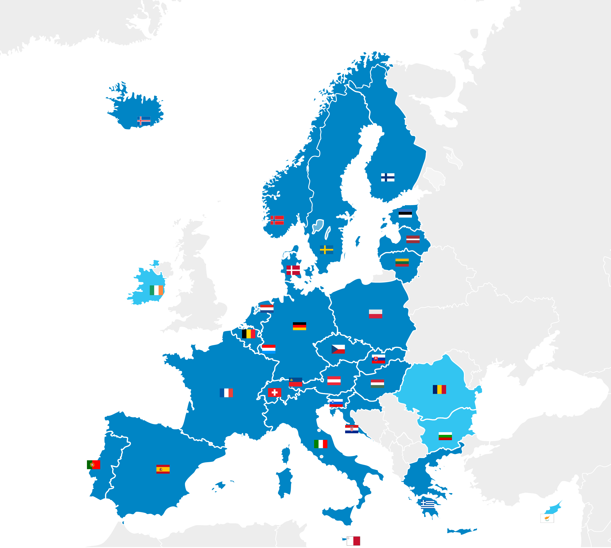
SCHENGEN AREA
Did you know?
You can travel freely between the 27 countries of the Schengen area without showing your passport
THE EUROPEAN PROJECT
Schengen area countries
Non-Schengen area EU countries
Notes:
The Schengen area was established in 1995 for EU countries to remove controls at their borders.
EU citizens can move freely within this area. The Schengen area brings together 23 EU countries (Austria, Belgium, Croatia, Czechia, Denmark, Estonia, Finland, France, Germany, Greece, Hungary, Italy, Latvia, Lithuania, Luxembourg, Malta, Netherlands, Poland, Portugal, Slovakia, Slovenia, Spain, Sweden) and 4 non-EU countries (Iceland, Liechtenstein, Norway and Switzerland).

Slide 19
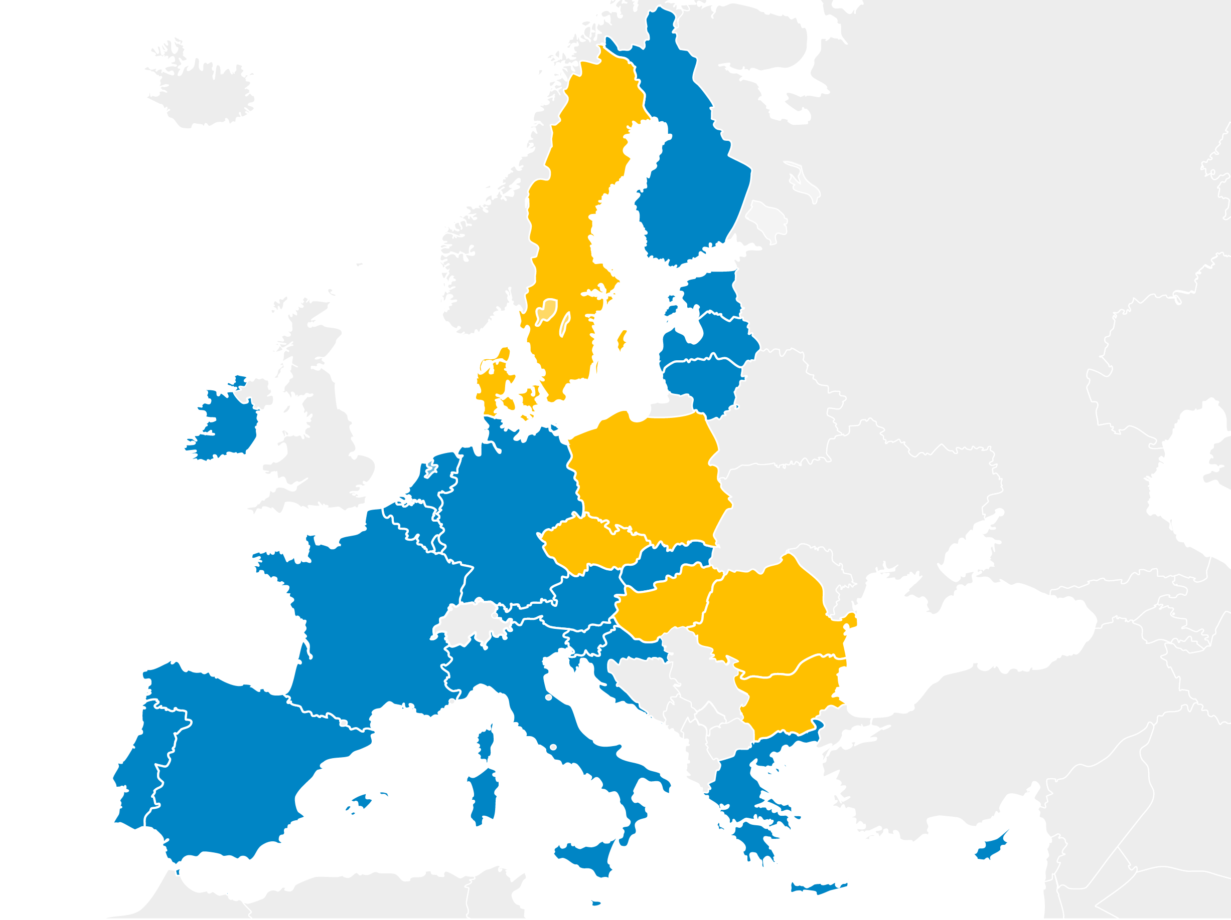
EURO AREA
20 EU countries now use the euro as their official currency
THE EUROPEAN PROJECT
EU countries that use the Euro
EU countries that do not use the Euro
Notes:
The euro replaced former national currencies and is currently used by 20 countries of the 27 EU countries: Austria, Belgium, Croatia, Cyprus, Estonia, Finland, France, Germany, Greece, Ireland, Italy, Latvia, Lithuania, Luxembourg, Malta, Netherlands, Portugal, Slovakia, Slovenia, Spain.

Slide 20
WHAT DOES THE EU DO ?

Slide 21
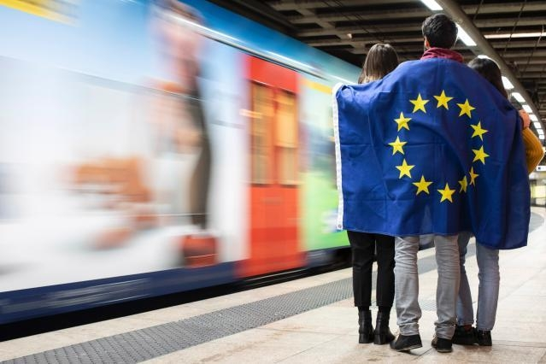
© EUROPEAN UNION
WHAT DO
YOU THINK
THE EUROPEAN UNION
DOES
FOR YOU?

Slide 22
STUDY, WORK AND VOLUNTEERING
© EUROPEAN UNION
Youth Guarantee Scheme
EURES
ERASMUS+
European Solidarity Corps
© EUROPEAN UNION
© EUROPEAN UNION
© EUROPEAN UNION
WHAT DOES THE EU DO?
Notes:
The Youth Guarantee Scheme is designed to help young people continue their education, or increase their chances of finding a job, by training them in the skills that employers need.
The EURES job website helps young people to start looking for a job, traineeship or apprenticeship in another EU country. Employers also use it to find candidates in other EU countries.
The Erasmus+ programme is open to both teenagers and adults from EU and non-EU countries and allows you to study, train or take part in a youth exchange in one of 33 countries around Europe and beyond.
The European Solidarity Corps programme enables young adults to volunteer abroad (or at home) for a cause that is important to them. This enriching experience allows them to develop their skills and competences.
Find out more here: Work and study (europa.eu)

Slide 23
TRAVELS
Discover EU
Healthcare assistance
Passenger rights
Access to digital subscriptions
Free roaming
© EUROPEAN UNION
© EUROPEAN UNION
© EUROPEAN UNION
© EUROPEAN UNION
© EUROPEAN UNION
WHAT DOES THE EU DO?
Notes:
DiscoverEU is an initiative of the European Union that gives 18-year-olds the opportunity to discover Europe by travelling.
When abroad, you can use your mobile phone just like at home without paying any extra fees.
If your flight, bus, train or ship is cancelled, you will be reimbursed because you are protected by a full set of passenger rights.
In case of an emergency, you can get healthcare in any EU country thanks to the European Health Insurance Card.
You can still watch your favourite series because you benefit from EU-wide access to your digital subscriptions

Slide 24
…AND MUCH MORE
EU in the world
Participation
Consumer rights and safety
EU-funded projects
Environmental protection
© EUROPEAN UNION
© EUROPEAN UNION
© EUROPEAN UNION
© EUROPEAN UNION
© EUROPEAN UNION
WHAT DOES THE EU DO?
Notes:
Participation: you can contribute to shaping Europe by, for example:
voting in the European Parliamentary election: : the voting age is 18 in most EU countries, 17 in Greece and 16 in Austria and Malta. Belgium and Germany have recently lowered the voting age for the European elections to come to 16.
launching or supporting the European Citizens’ Initiative that calls on the EU to propose new legislation on a specific issue for which it is responsible;
attending Citizens’ Dialogues that take place across the EU, where you get the chance to discuss European issues with representatives of the EU.
Environmental protection:
The fight against climate change is a top priority for the EU. All EU countries have agreed that by 2030 they should drastically reduce their greenhouse gas emissions and energy use, and produce more of their energy from renewable sources (such as wind, solar or hydro power).
Natura 2000 is a network of protected areas in the world. It protects around 2000 animal and plant species and 230 habitat types throughout the EU. Click here for more information: https://europa.eu/!vC49dj.
The EU LIFE programme funds projects that protect the environment and fight climate change. Click here to find the projects carried out in your country: LIFE in European countries (europa.eu)
Consumer rights and safety: Products such as food, toys and cosmetics have to meet strict safety requirements before they can be sold within the EU. EU law also gives you a minimum 2-year guarantee when you buy consumer goods and allows you to return the goods you have bought within 14 days if you change your mind. Moreover, thanks to the EU General Data Protection Regulation, consumer privacy is constantly protected. The EU also works to stop the spread of disinformation.
EU-funded projects: The European Union helps improve people’s lives by:
supporting new jobs
building new infrastructure
funding scientific research
modernising public services such as schools and hospitals.
For more information https://europa.eu/!Qg69NV and https://europa.eu/!wC93kF
EU in the world:
The EU has signed trade agreements with many countries around the world, which make it easier to do business together. You can find more information here: https://europa.eu/!gv87hU;
the EU also carries out humanitarian projects, aimed at providing vulnerable people with food, shelter, medical care and education. You can find more information here: https://europa.eu/!rV69JX;
In case of disasters, the EU can provide aid and assistance through a coordinated response system known as the Civil Protection Mechanism. You can find more information here: https://europa.eu/!Pw88qb.

Slide 25
EU PRIORITIES
Green Deal
NextGenerationEU
Digitalisation
Equality
© EUROPEAN UNION
© EUROPEAN UNION
© EUROPEAN UNION
© EUROPEAN UNION
WHAT DOES THE EU DO?
Notes:
With the European Green Deal, the EU aims to cut its emissions and become the first climate neutral continent by 2050. Find out more about the Green Deal here: https://europa.eu/!Tr74bn
NextGenerationEU is a campaign aimed at:
explaining to citizens what the EU is doing to reboot the economy after the crisis caused by the COVID-19 pandemic;
building a more resilient future for the EU ;
making the EU safer, green, healthier, digital and equal.
Digitalisation: The EU is working to provide internet access to all people living in the EU (Wifi4EU initiative), while keeping children and young adults safe when using the internet or mobile technologies (Better Internet for Kids).
Equality: The EU is engaged in achieving a Union of equality, which means creating the conditions for everyone to live, thrive and lead regardless of differences based on sex, racial or ethnic origin, religion or belief, disability, age or sexual orientation. To achieve this goal, the EU is putting in place mechanisms, policies and actions that challenge structural discrimination and the stereotypes that are often present in our societies.
For more information: The European Commission’s priorities | European Commission (europa.eu)

Slide 26
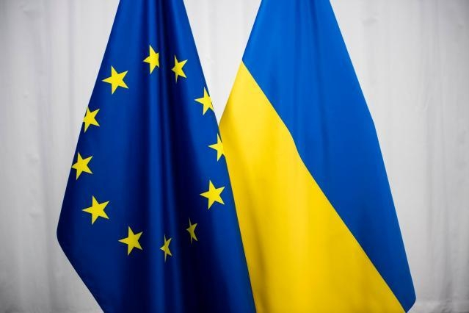
2022: EU SOLIDARITY WITH UKRAINE
WHAT DOES THE EU DO?
#StandWithUkraine
Notes:
On 24 February 2022, Europe woke up to harrowing news about Russia’s military aggression against Ukraine. This is not only an attack against Ukraine, but also against the values that we uphold in the European Union. As a Union built on peace, democracy and rule of law, the atrocities taking place on our border remind us of the very reason that the EU was created. The EU has responded with unity, strength and rapidity to this crisis, as it has done throughout the many challenges of the preceding year.
https://ec.europa.eu/info/strategy/priorities-2019-2024/stronger-europe-world/eu-solidarity-ukraine_en

Slide 27
2022: THE EUROPEAN YEAR OF YOUTH
European Year of Youth
© EUROPEAN UNION
WHAT DOES THE EU DO?
Notes:
The European Year of Youth: 2022 was the Year of Youth. It promoted opportunities for young people and engaged them to become active citizens and actors of change. The aim was to give young people more and better opportunities for the future. For more information on the outcomes of the year: What is the European Year of Youth? | European Youth Portal (europa.eu)

Slide 28
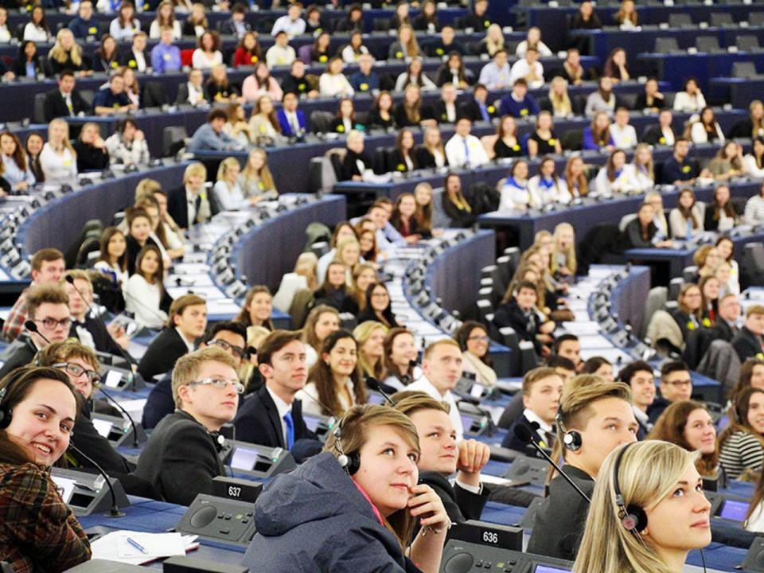
Which topics do you think
should be prioritised by the European Institutions?
© EUROPEAN UNION
Notes:
Sample topics:
Human rights (e.g. LGBTIQ rights)
Environment (e.g. climate change)
Employment (e.g. how to get a job after studies)
Youth (e.g. opportunities for young people)
Social inclusion (e.g. gender equality)
Education (e.g. how to study in another country/ how to get the money for higher education after finishing secondary school)
Health

Slide 29
HOW DOES THE EU WORK ?

Slide 30
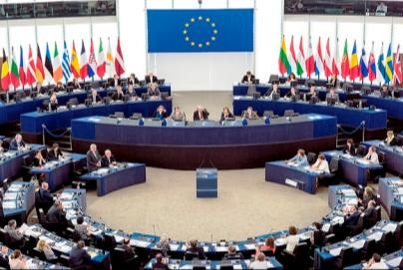
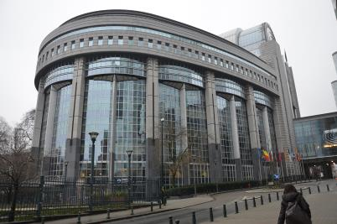
THE EUROPEAN PARLIAMENT
is the voice of European citizens
has Members from all EU countries directly elected by citizens every five years
discusses new laws proposed by the European Commission
modifies (if necessary) and decides these laws together with the Council
elects the President of the European Commission
approves the EU budget
holds at least six sessions per year in Brussels (Belgium) and 12 in Strasbourg (France)
© EUROPEAN UNION
HOW DOES THE EU WORK?
© Creative Commons Attribution-Share Alike 4.0 International
Notes:
Go to europarl.europa.eu to access the official website of the European Parliament.

Slide 31
THE EUROPEAN COUNCIL
brings together the heads of state or government of each EU country
sets the EU’s main priorities and policy directions
meets at least four times a year in Brussels (Belgium) or Luxembourg (Luxembourg) for European Summits
does not adopt EU laws
HOW DOES THE EU WORK?
© EUROPEAN UNION
Notes:
Go to consilium.europa.eu to access the official website of the Council of the EU.

Slide 32
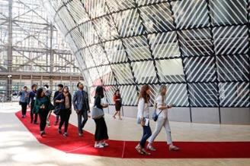
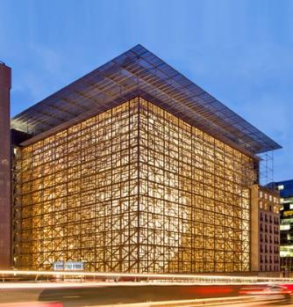
THE COUNCIL OF THE EU
represents the governments of the EU countries
brings together ministers of EU countries who meet to discuss EU matters (agriculture, foreign affairs, justice, etc.)
takes decisions and passes laws together with the European Parliament
has a rotating Presidency – every six months another EU country takes the lead
meets in Brussels or Luxembourg
© EUROPEAN UNION
HOW DOES THE EU WORK?
© EUROPEAN UNION
Notes:
Go to consilium.europa.eu to access the official website of the Council of the EU.

Slide 33
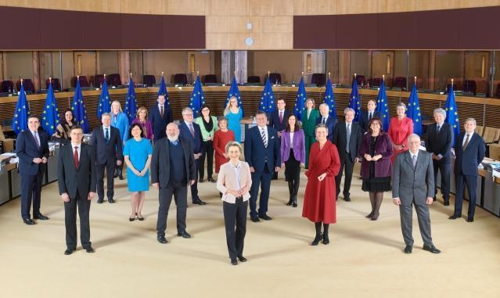
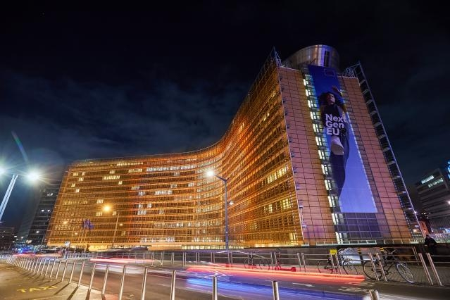
THE EUROPEAN COMMISSION
represents the EU common interests
is made up of one President and a Commissioner from each EU country responsible for a specific topic
proposes new laws and programmes
is elected by the European Parliament for five years
manages the EU policies and budget
is the guardian of the EU Treaties
is located in Brussels and Luxembourg
© EUROPEAN UNION
HOW DOES THE EU WORK?
© EUROPEAN UNION
© EUROPEAN UNION
Notes:
Go to ec.europa.eu to access the official website of the European Commission.

Slide 34
EU LAWS: WHO DOES WHAT?
European Commission
Proposes a law
Adopt, amend or reject the proposed law
European Parliament
Council of the European Union
If agreed
HOW DOES THE EU WORK?
NEW EU LAW

Slide 35
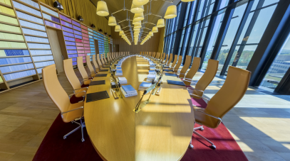
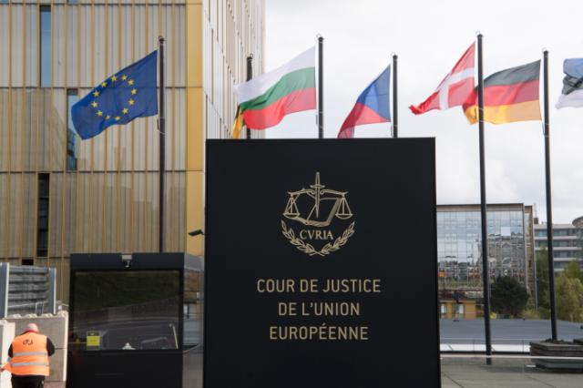
THE EUROPEAN COURT OF JUSTICE
keeps track of EU laws
makes sure that EU countries respect EU laws
advises national courts on the interpretation of these laws
fines countries if they do not respect EU laws
checks if the laws respect fundamental rights (e.g. freedom of speech, freedom of the press)
consists of one judge per EU country
is located in Luxembourg
© EUROPEAN UNION
HOW DOES THE EU WORK?
© EUROPEAN UNION
Notes:
Go to curia.europa.eu to access the official website of the European Court of Justice.

Slide 36
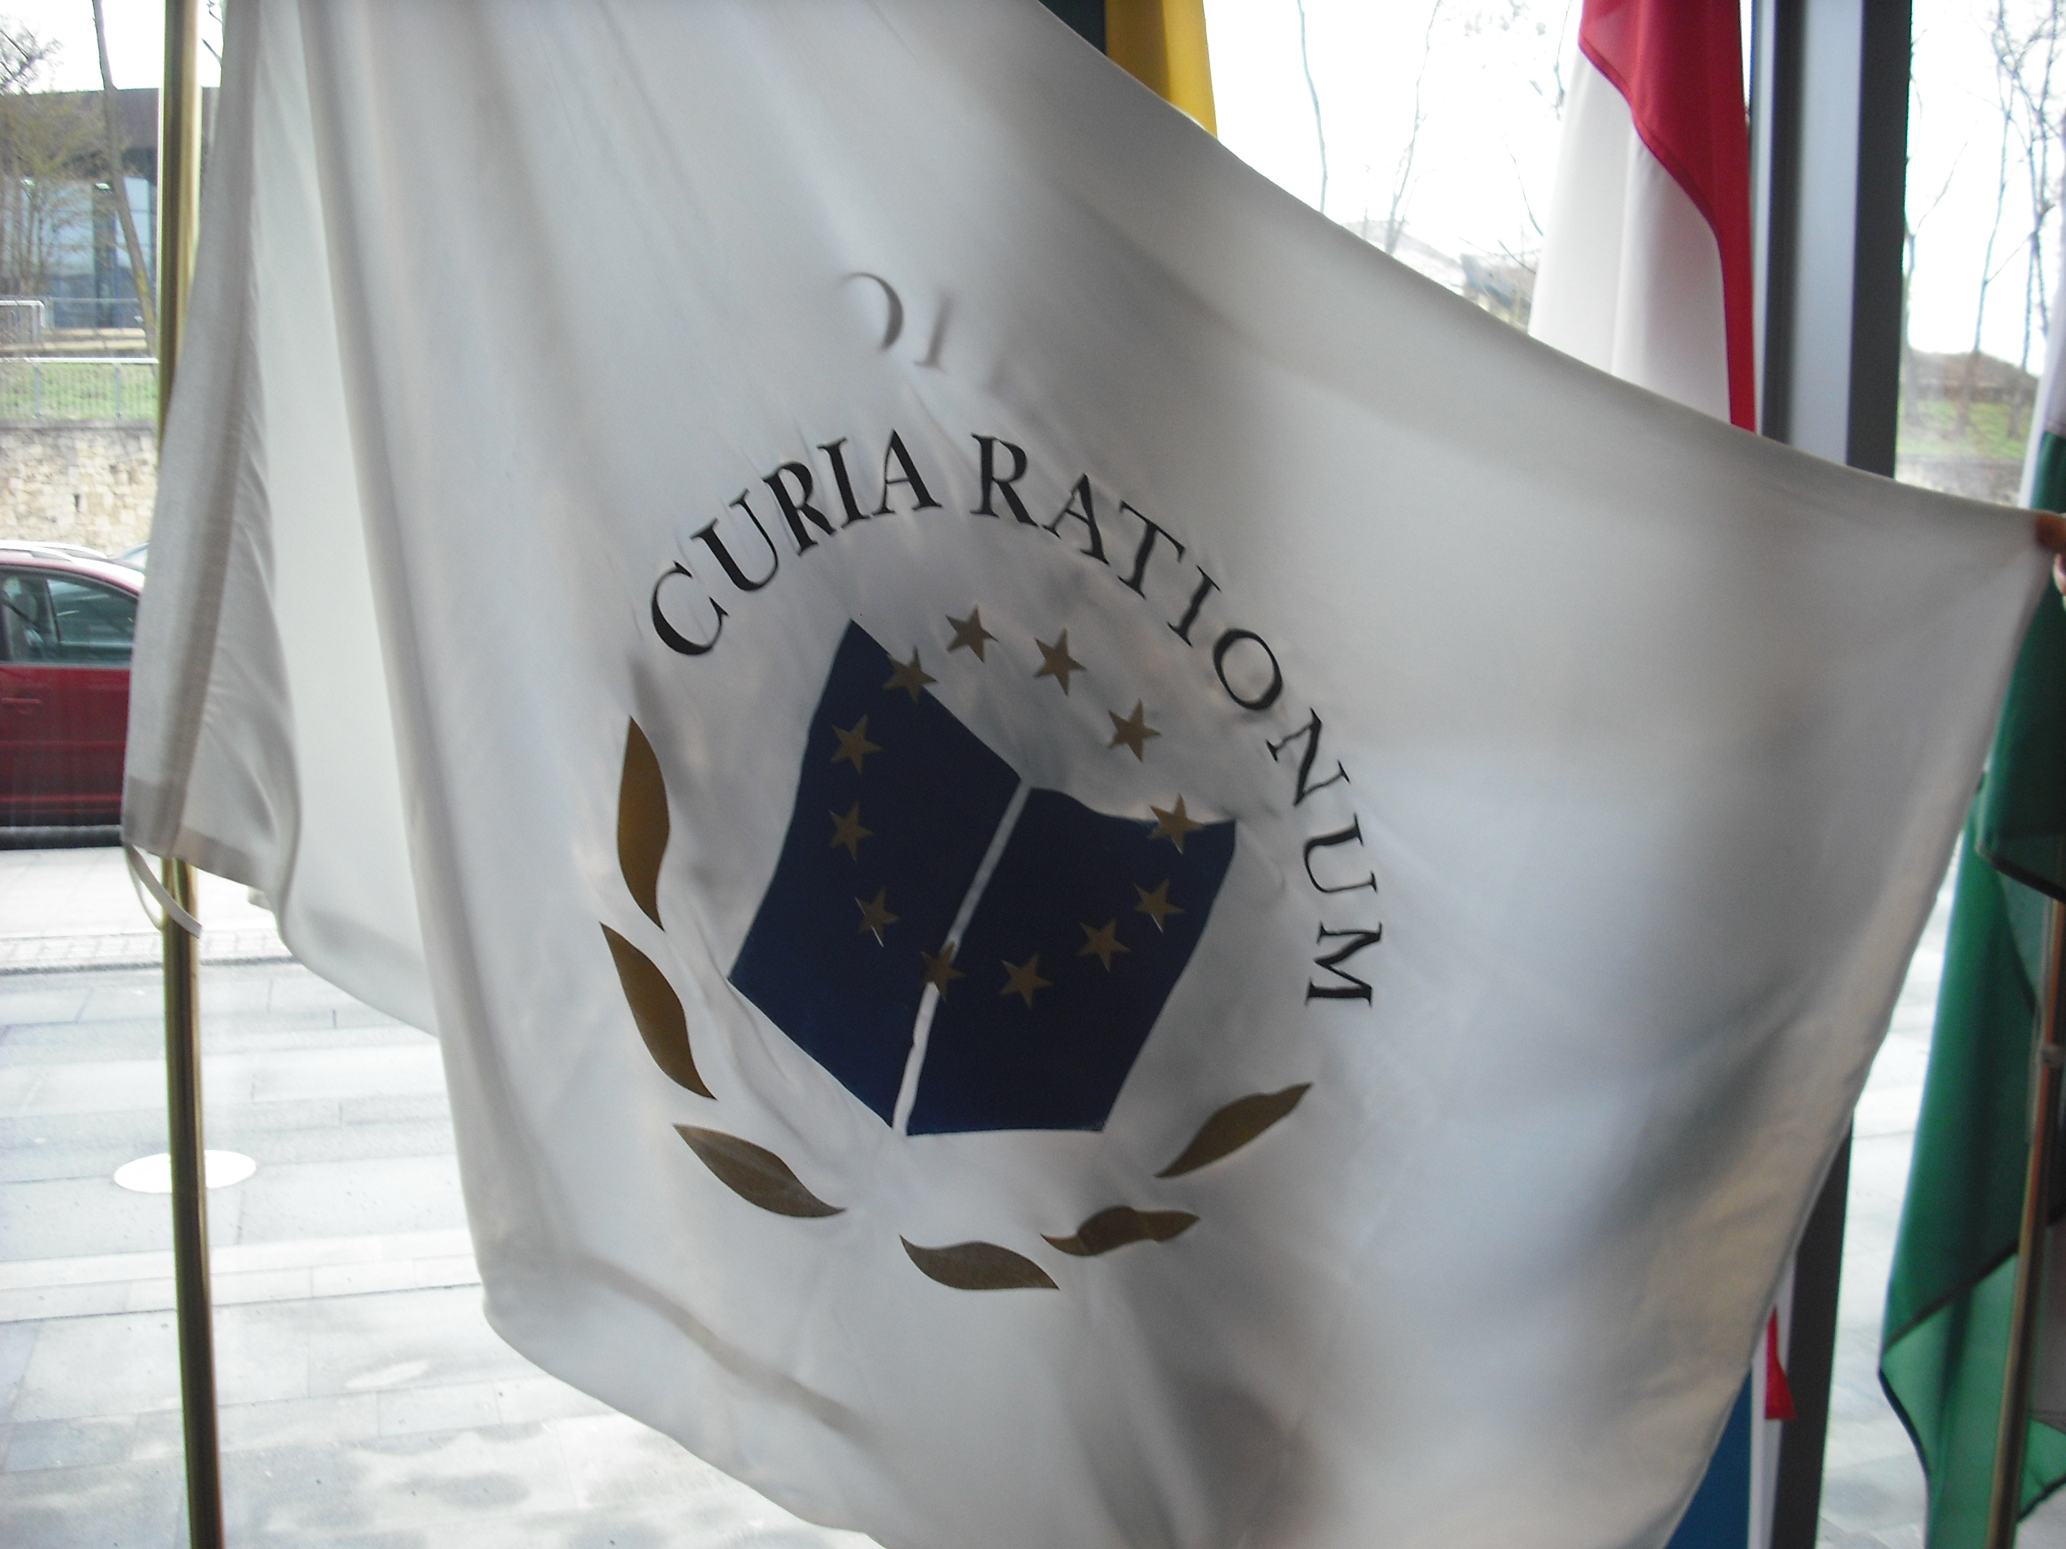
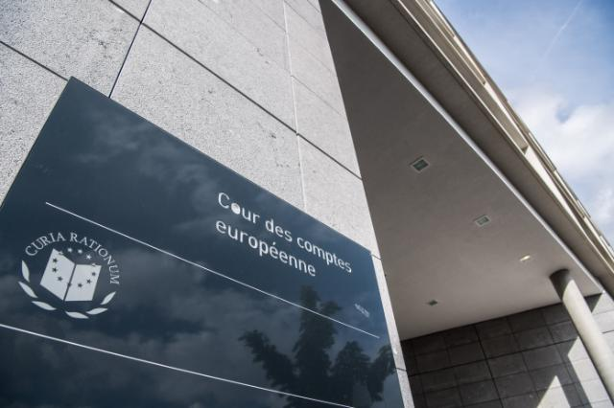
THE EUROPEAN COURT OF AUDITORS
checks whether the EU’s budget has been correctly spent
reports fraud, corruption or other illegal activity
advises EU policymakers on how to best spend the budget
has Members appointed by the Council for six-year terms
HOW DOES THE EU WORK?
@TRANSPARENCY INTERNATIONAL
© EUROPEAN UNION
© EUROPEAN UNION
Notes:
Go to eca.europa.eu to access the official website of the European Court of Auditors.

Slide 37
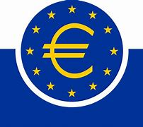
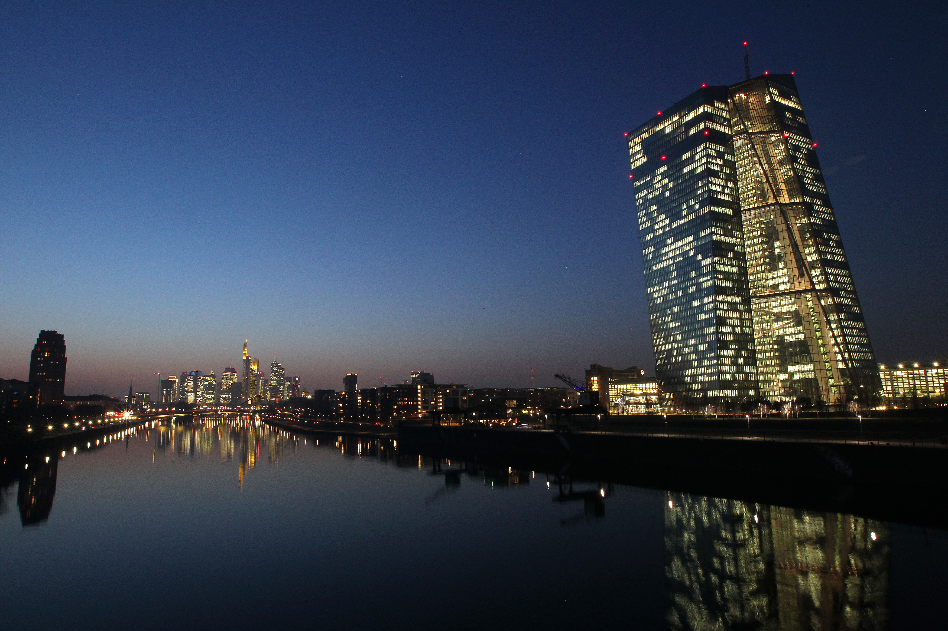
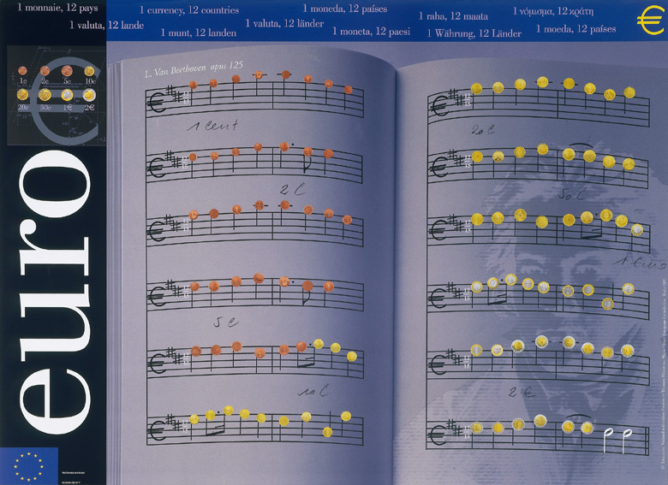
THE EUROPEAN CENTRAL BANK
leads EU economic and monetary policy
manages the European currency – the ‘euro’
is responsible for keeping the euro and prices stable
fixes interest rates for the euro area
works with the national central banks of EU countries
has six Members appointed by the Council for an eight-year term that cannot be renewed
is located in Frankfurt (Germany)
© EUROPEAN UNION
HOW DOES THE EU WORK?
© EUROPEAN UNION
Notes:
Go to www.ecb.europa.eu to access the official website of the European Central Bank.

Slide 38
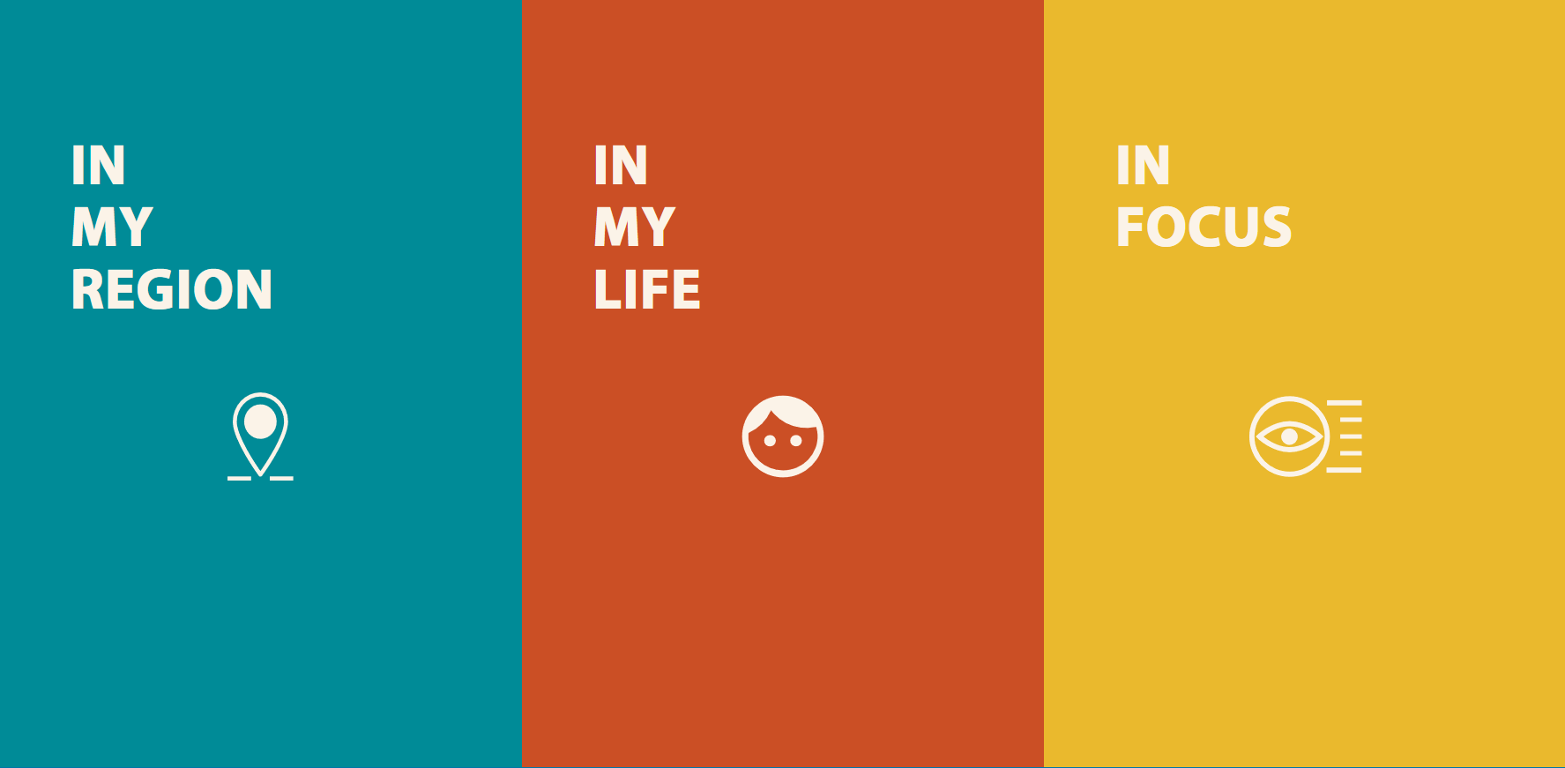
HOW CAN I LEARN MORE ABOUT THE EU?
Europa website
europa.eu
What Europe does for me
what-europe-does-for-me.eu
Learning Corner website
europa.eu/learning-corner
Learning Corner newsletter
ec.europa.eu/newsroom/comm/user-subscriptions/1595/create
Publications Office
publications.europa.eu
HOW CAN I LEARN MORE? ?

Slide 39
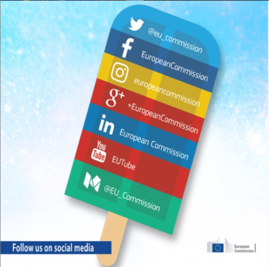
STAY IN TOUCH
In person:
Via social media:
> Questions about the EU? Europe Direct can help.
© EUROPEAN UNION
europa.eu/european-union/contact_en
Freephone: 00 800 6 7 8 9 10 11
> Find an EU centre near you to meet, ask, discuss about the EU.
europa.eu/european-union/contact/meet-us_en
Use the search tool to find the EU’s social media accounts.
europa.eu/european-union/contact/social-networks_en
STAY IN TOUCH

Slide 40
Thank you!
europa.eu/learning-corner
✉ COMM-A2@ec.europa.eu
© European Union, 2022
Unless otherwise noted the reuse of this presentation is authorised under the CC BY 4.0 license. For any use or reproduction of elements that are not owned by the EU, permission may need to be sought directly from the respective right holders.

