Slide 1
How to spot and fight disinformation
©Freepik
Notes:
Hands up – who has encountered disinformation today? How about in the last week? In the last month? In the last year?

Slide 2
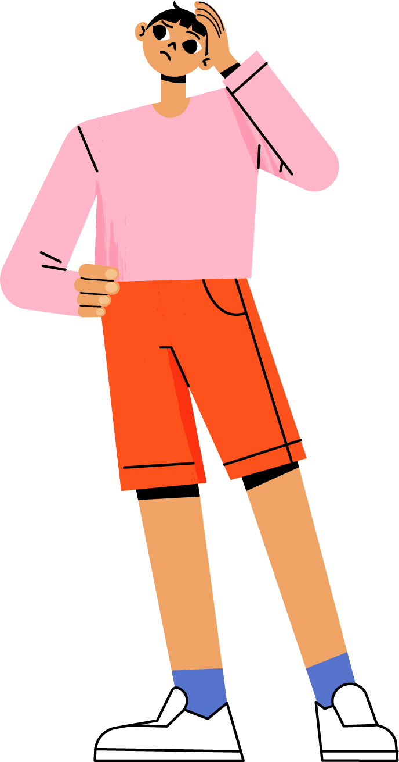
What will we learn?
WHAT
HOW
HOW
is disinformation?
does it work?
do I respond?
©Freepik
Notes:
Today, we will talk about what disinformation is, how it works and give you some tips on how to spot disinformation, how to protect yourself from it and how to help others too!

Slide 3


PART 1
What is disinformation?
©Freepik

Slide 4


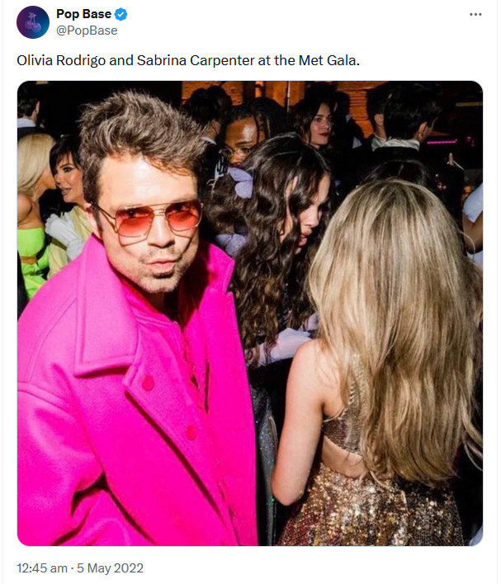
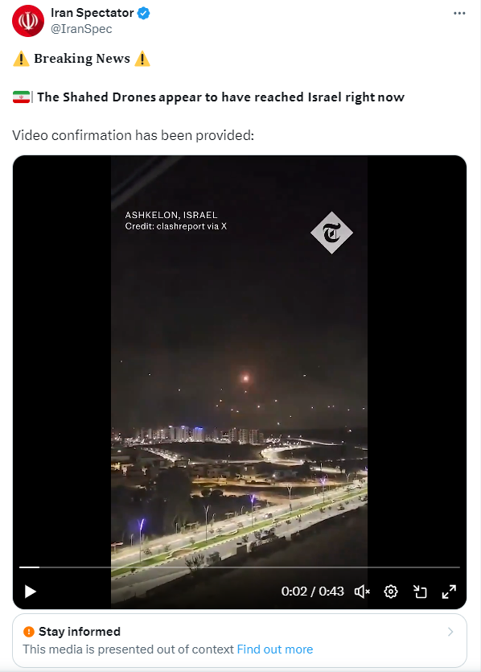

Part 1: What is disinformation?
Notes:
We live in an information age. Information has never been as accessible as today.
However, this doesn’t always make life easier – it can be very difficult to tell what’s true and what is false.
For example, although it seemed unlikely at the time, Olivia Rodrigo and Sabrina Carpenter did talk at the Met Gala, whereas the Forbes cover with the Grand Ayatollah Sayyid li Khamenei looks very real, but is in fact fake. The picture in the middle does show the activation by Israel of the Iron dome, but on the wrong date, thus involving different actors.
In this presentation we will look not just at disinformation (when a person or organisation intentionally spreads information they know to be false or misleading), but also other forms of false information you might come across, and how you can protect yourself from it.
Be careful what you believe – always think (and factcheck!) before you share.
Sources:
Social media post on encounter between Olivia Rodrigo and Sabrina Carpenter: https://twitter.com/PopBase/status/1521984278057218050?lang=en
Video on Iron dome being activated: (3) Iran Spectator on X: "⚠️ 𝐁𝐫𝐞𝐚𝐤𝐢𝐧𝐠 𝐍𝐞𝐰𝐬 ⚠️ 🇮🇷| 𝗧𝗵𝗲 𝗦𝗵𝗮𝗵𝗲𝗱 𝗗𝗿𝗼𝗻𝗲𝘀 𝗮𝗽𝗽𝗲𝗮𝗿 𝘁𝗼 𝗵𝗮𝘃𝗲 𝗿𝗲𝗮𝗰𝗵𝗲𝗱 𝗜𝘀𝗿𝗮𝗲𝗹 𝗿𝗶𝗴𝗵𝘁 𝗻𝗼𝘄 Video confirmation has been provided: https://t.co/5Mt7VfstLB" / X (twitter.com)
Fake Forbes Magazine cover: https://u.afp.com/5Arh

Slide 5

Part 1: What is disinformation?
WHY might someone spread information that isn’t true?
Because it’s a joke ➔ Satire/humour
Because they believe it ➔ Misinformation
Because they want to deceive people ➔ Disinformation
Notes:
Satire/humour: joke articles by satirical news outlets sometimes get mistaken for real news.
Misinformation: false or misleading information shared by people who believe it and do not want to cause harm. Often they are just trying to help. Example: An uncle posts an article on Facebook about garlic preventing cancer because he thinks it's useful information and doesn't realise it's false.
Disinformation: false information that is created and shared to deceive people or in order to achieve a political or economic goal and which may cause public harm. Example: a social media post with false stories about migrants committing crimes in Europe that was created to divide society.

Slide 6


Satire - ‘Dozens injured in stampede in Lidl’
Part 1: What is disinformation?
Pope wearing a Balenciaga puffer jacket
➔ Humour
©Pablo Xavier
© Mazur/catholicnews.org.uk
Notes:
*Note* - This slide has animations.
Humour can easily be mistaken for real news, if you’re not careful.
The image of the Pope in a puffer jacket was first posted on a Facebook group called AI Art Universe in March 2023 and quickly went viral.
https://www.buzzfeednews.com/article/chrisstokelwalker/pope-puffy-jacket-ai-midjourney-image-creator-interview
You can find more AI-generated images of Pope Francis here: https://www.nytimes.com/2023/04/08/technology/ai-photos-pope-francis.html
Second Pope pic
https://www.pillarcatholic.com/p/why-is-pope-francis-embracing-the

Slide 7


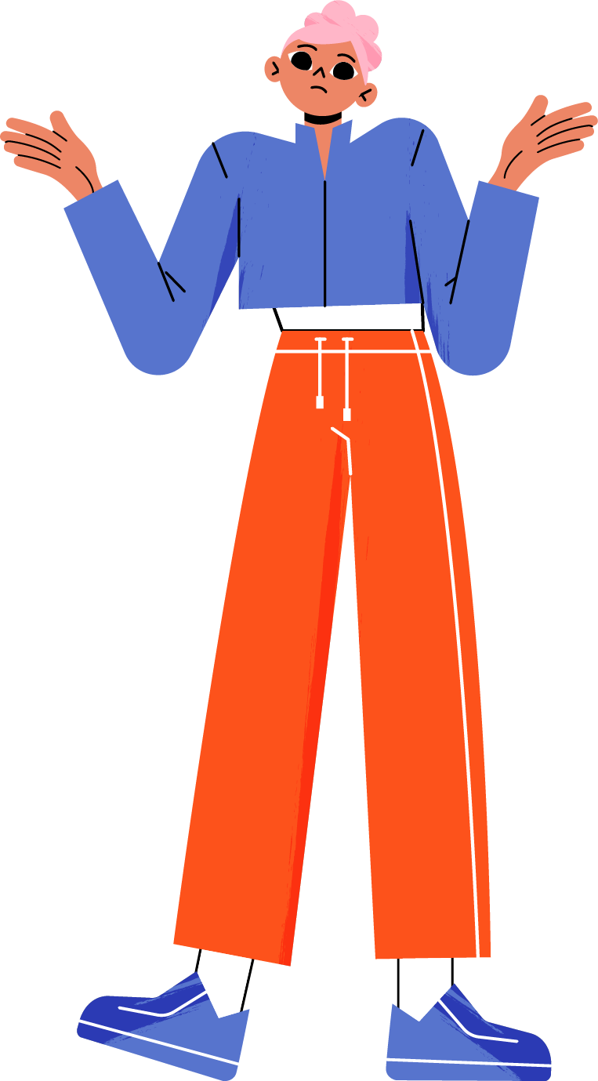
Misinformation – ‘5G causes coronavirus’
Part 1: What is disinformation?
‘5G caused and spread coronavirus’
Playing on:
Existing conspiracy theories about supposed 5G health impacts;
Uncertainty and fear in the early days of the pandemic.
Consequences:
Vandalism of 5G towers;
Disruption of telecommunication services;
Harassment of telecom services employees.
➔ Misinformation
©Freepik
Notes:
*Note* - This slide has animations.
Often, false information spreads because people genuinely believe it and want to share what they’ve learned with friends or family. In this case, we call it ‘misinformation’.
During the COVID-19 pandemic, much confusing information spread on social media. For example, many claimed there was a link between 5G technologies and the spread of coronavirus (you can read more about this here: https://www.euronews.com/2020/05/15/what-is-the-truth-behind-the-5g-coronavirus-conspiracy-theory-culture-clash).
This theory has caused real harm:
Arsonists set fire to cell towers across Europe
Telecommunications networks failed, as many of the towers destroyed and vandalised were for 3G and 4G service, which the public depends on (e.g. to call an ambulance…)
Telecoms employees were harassed and attacked on the street for laying down 5G fiber-optic cable or any other type of telecommunications infrastructure.
[This conspiracy theory linking the installation of 5G towers with the outbreak of COVID-19 is thought to have arisen in France in January 2020 and quickly spread to other countries.]

Slide 8
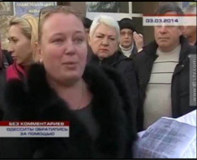
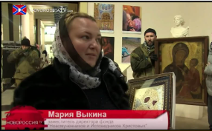
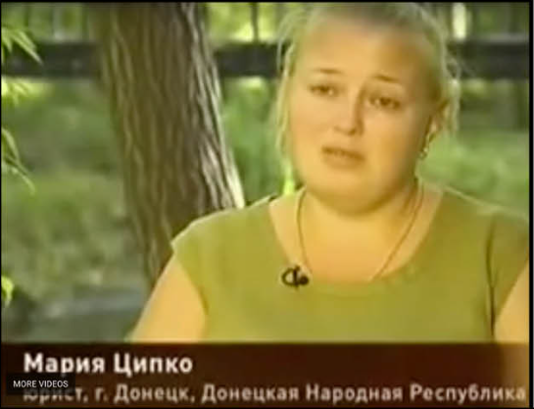
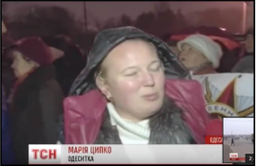

Part 1: What is disinformation?
I’m a mother from Odesa, Ukraine.
I’m the vice-chair
of a Russian religious foundation.
I’m a lawyer from Donetsk, Ukraine.
I’m a citizen
of Kharkiv, Ukraine.
Same person poses as
different people.
➔ Disinformation
Image Source – vesti-ukr, stopfake.org, stopfake.org, YouTube.
Notes:
*Note* - This slide has animations.
- This is an example of disinformation – a woman is pretending to be a local person experiencing anti-Russian discrimination, to deceive people and promote Russian political goals.
- She appeared in all these roles within 1 year
- Real people might not stick exactly to the message that the people behind this propaganda want to deliver, so they use professional actors to impersonate various emotionally moving characters. The aim is to manufacture pro-Russian and anti-Ukrainian sentiment.
Source: Russian disinfo patterns: same actors, different sets | StopFake. Link: https://www.stopfake.org/en/russian-disinfo-patterns-same-actors-different-sets/
First image > video: (https://youtu.be/9jnq3MRLsEU?feature=shared&t=171)
Total time: 40” (from 2min51sec to 3min31sec)
Transcript (translated):
---------------------------
(Taken from a Crimean TV station report on a public rally in Sevastopol, Crimea on 3 March 2014. The woman calls herself Maria and claims to be from Odesa)
Teachers from the school are calling and asking for protection. My children go to the Russian school and I am on the parents’ board.
When I come to school, my children ask “Will we go to prison now too for learning the Russian language and speaking Russian?”
In order to reach you we had to switch off our cell phones and take the batteries out.
Huge persecution has started – it is truly horrible.
---------------------------

Slide 9
PART 2
How does disinformation work?
©Freepik

Slide 10

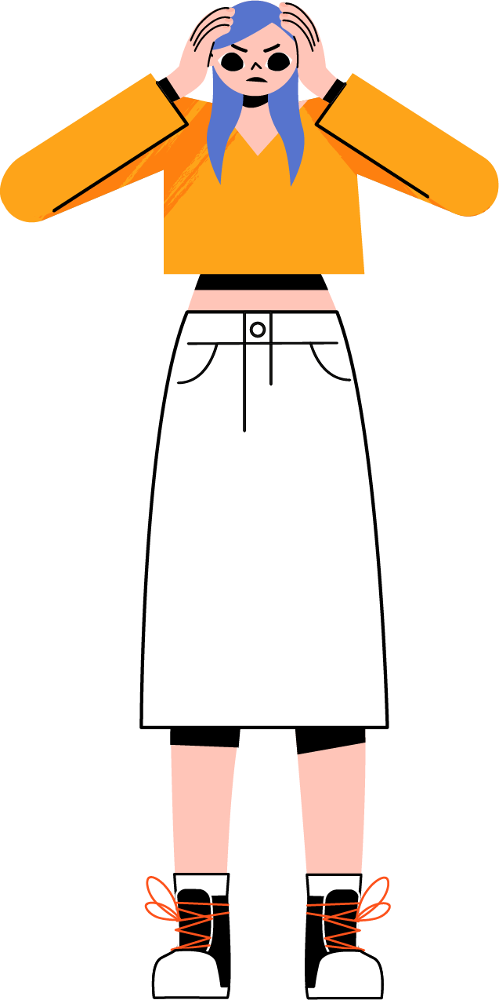
Part 2: How does disinformation work?
The aim of disinformation is not necessarily to convince, but to confuse.
Tactics include:
I don’t know who I can trust anymore!
  Whataboutism
  drawing attention to unrelated, or distantly related issues.
  Strawman misrepresenting others’ position and attacking it.
  Attack
  scaring off ‘doubters’ by using aggressive or demeaning language.
  Mockery
  making fun of ‘doubters’; using sarcasm.
Overwhelm with detail
distract from the main point
©Freepik
Notes:
Disinformation-spreaders use social media to flood the information space
Their aim is not necessarily to convince you of one particular story – if they can succeed in confusing or overwhelming us so much that we don’t know who to trust, they can undermine our trust in mainstream media and in democracy
Disinformation-spreaders use several techniques, which you can often see in comments on social media.
Whataboutism – instead of discussing the topic at hand, the commenter draws attention to an unrelated, or distantly related, topic. Example: In a discussion about the Russian invasion of Ukraine, a commenter suddenly asks ‘What about Somalia?’. Their aim is not to have a constructive discussion about Somalia, but rather to distract from the topic of the conversation.
Strawman - the commenter misrepresents the other person’s position and attacks that instead. Example: Malik posts about the importance of Europe becoming climate-neutral. Sarah comments ‘I can’t believe you want to build wind farms in all our national parks’. Malik didn’t say that, but it’s very easy for him now to end up arguing about windfarms specifically instead of the bigger picture.
Attack - the commenter uses aggressive or demeaning language to discourage the opponent from further discussion. Example: ‘Only an idiot would believe that’.
Mockery – the commentator uses sarcasm to disparage opponents. Example: Sara responds to Malik’s post with ‘I’m so glad we have people like you to take the fun out of everything’.
Overwhelm with detail - the commentator overwhelms the opponent with details (often technical ones) to distract from important information. Example: In a discussion about the Russian invasion of Ukraine, a commenter writes a long response about the demography of a small village in Donbas, arguing that anyone who doesn’t already know this has no right to talk about the situation in Ukraine.
This can be a particularly difficult strategy to respond to. It is possible that the person using it really believes what they’re saying, but this tactic is also often used intentionally by people who want to derail a discussion. Remember that it’s okay to say you don’t know every single detail about a particular topic – it doesn’t mean that the other person has ‘won’ the argument.

Slide 11
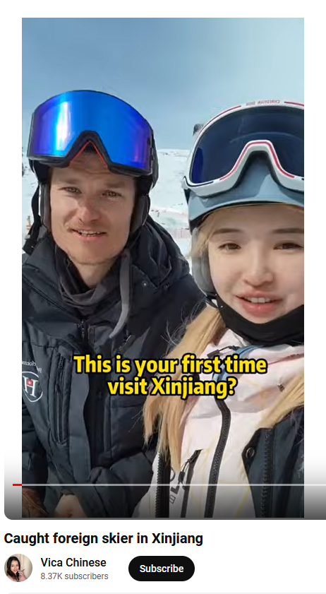
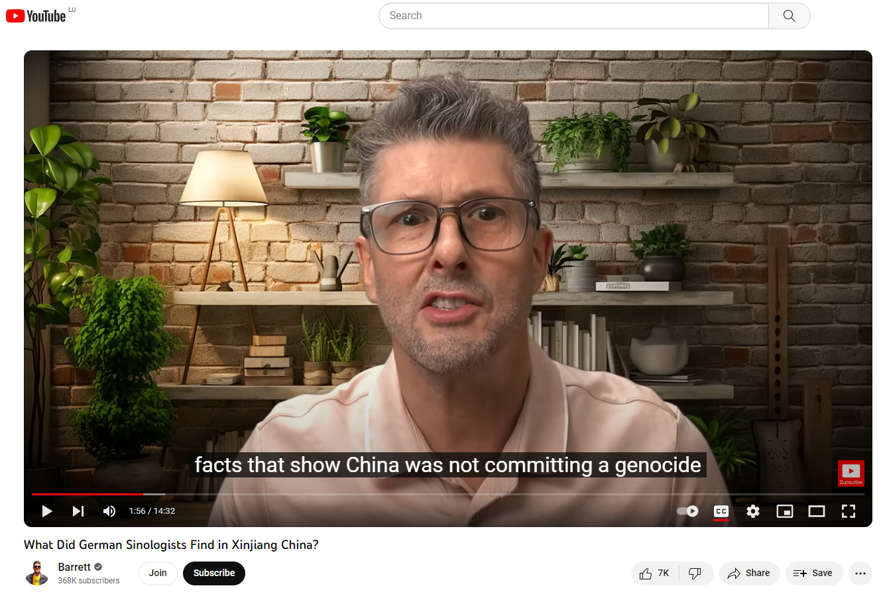
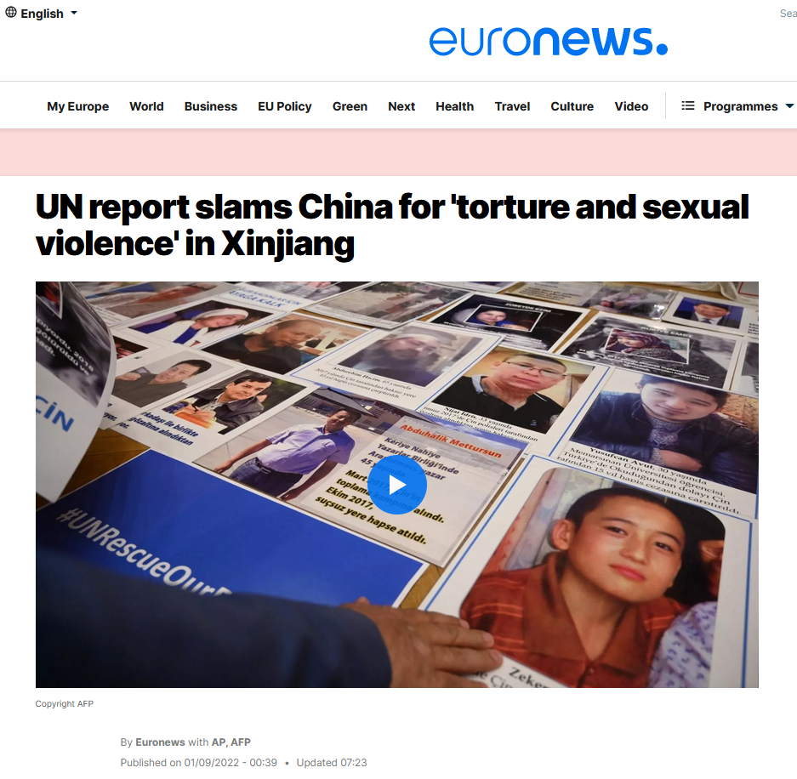
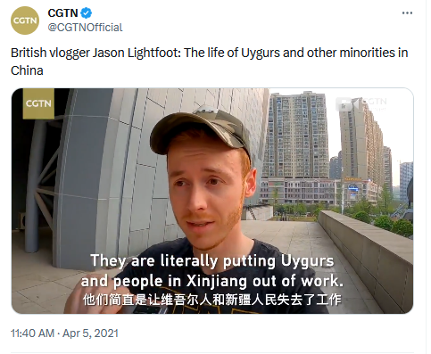
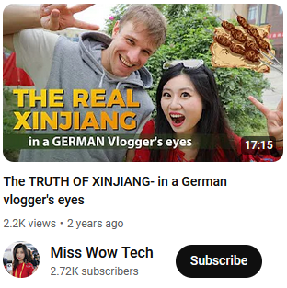
Part 2: How does disinformation work?
Notes:
Social media plays a tremendous role in amplifying or stopping disinformation from spreading.
Social media platforms use algorithms to keep you engaged – they try to show you content that you will find interesting.
Sometimes this is good – you might find out more about topics you’re genuinely interested in. But if you spend more time looking at a post because it makes you angry, or sad, the algorithm will promote similar content to you.
You can easily find yourself overwhelmed by confusing or disturbing content, so try to take a break if you find that happening.
Sources:
https://www.euronews.com/2022/09/01/un-report-slams-china-for-torture-and-sexual-violence-in-xinjiang
https://www.bbc.com/news/world-asia-china-57780023
https://apnews.com/article/china-tiktok-facebook-influencers-propaganda-81388bca676c560e02a1b493ea9d6760
A search for information on ‘Xinjiang’ may trigger very different results, as illustrated on this slide, ranging from praising it as a tourist destination to criticising treatment of Uygurs and other minorities by the Chinese government. Which one is true, which one is false?
While it may be true that Xinjiang is very beautiful and a great tourist destination, that does not mean that it cannot also be a place where Uygurs and other minorities are subjected to human rights violations.
Promoting Xinjiang as a tourist destination distracts from the human rights violations.
[Text in images (left to right):
British vlogger : The life of Uyghurs and other minorities in China. “They are literally putting Uyghurs and people in Xinjiang out of work”
The real Xinjiang: in a GERMAN vlogger’s eyes
“This is your first time visiting Xinjiang?”

Slide 12

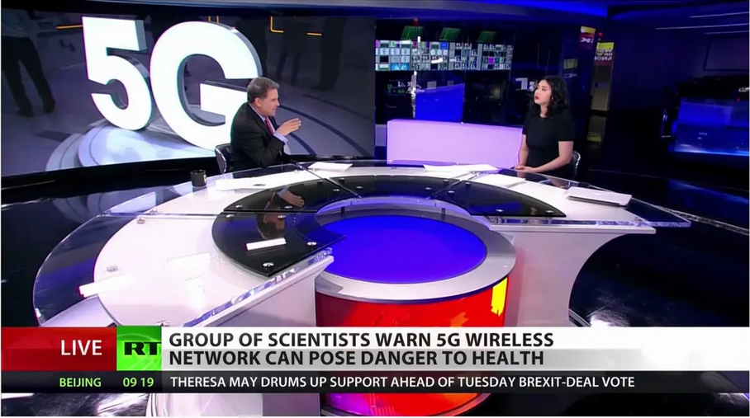


Part 2: How does disinformation work?
©Adobe Stock
Disinformation is not only on social media –
it also appears in traditional media
Notes:
*Note* - This slide has animation.
Disinformation is not a new phenomenon. It has existed for a long time, spreading through traditional media like newspapers, tv or the radio.
So don’t believe something just because you’ve seen it on paper or on TV rather than online – always check that the source is reliable, see what other sources are saying, and follow the other tips in slide 17.
Source: https://www.ft.com/content/1eeedb71-d9dc-4b13-9b45-fcb7898ae9e1
Source 5G: https://www.nytimes.com/2019/05/12/science/5g-phone-safety-health-russia.html

Slide 13

Part 2: How does disinformation work?
Notes:
This video, produced by EUvsDisinfo, explains how ‘propaganda videos’ (or disinformation videos) are created, for example by using imagery out of context to construct a false narrative by deconstructing this Sputnik story about children in ‘militarised’ Latvia getting indoctrinated by NATO: https://www.youtube.com/watch?v=nOd2vMCDv9M&feature=youtu.be [length: 2:05]
Let students reflect on their emotions. What do they feel when they see this? How would they react if this appeared in their news feed on Instagram/TikTok? Why do they feel emotional about this? The news in itself, the way it is formulated, the picture…?

Slide 14
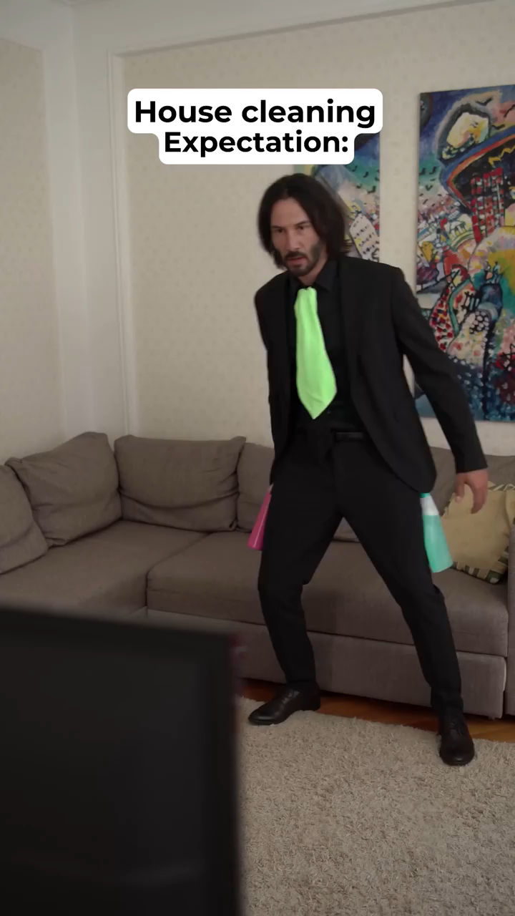
Part 2: How does disinformation work?
Notes:
Source:
https://youtube.com/shorts/FeHzQizPDNg?feature=shared
Deepfakes use artificial intelligence to create new footage (images, videos, voice recordings) that depicts events, statements or action that never actually happened. The results can be quite convincing.
In this video, it is not actually Keanu Reeves demonstrating his cleaning skills.
The EU and other organisations are working hard to counter malicious AI and deepfakes, but it isn’t always possible for someone who isn’t an expert to tell whether an image or a video is real or manipulated. Ask yourself the questions in Slide 17 and remember that if something seems too good to be true (or too shocking to be true), it might be – check carefully!

Slide 15
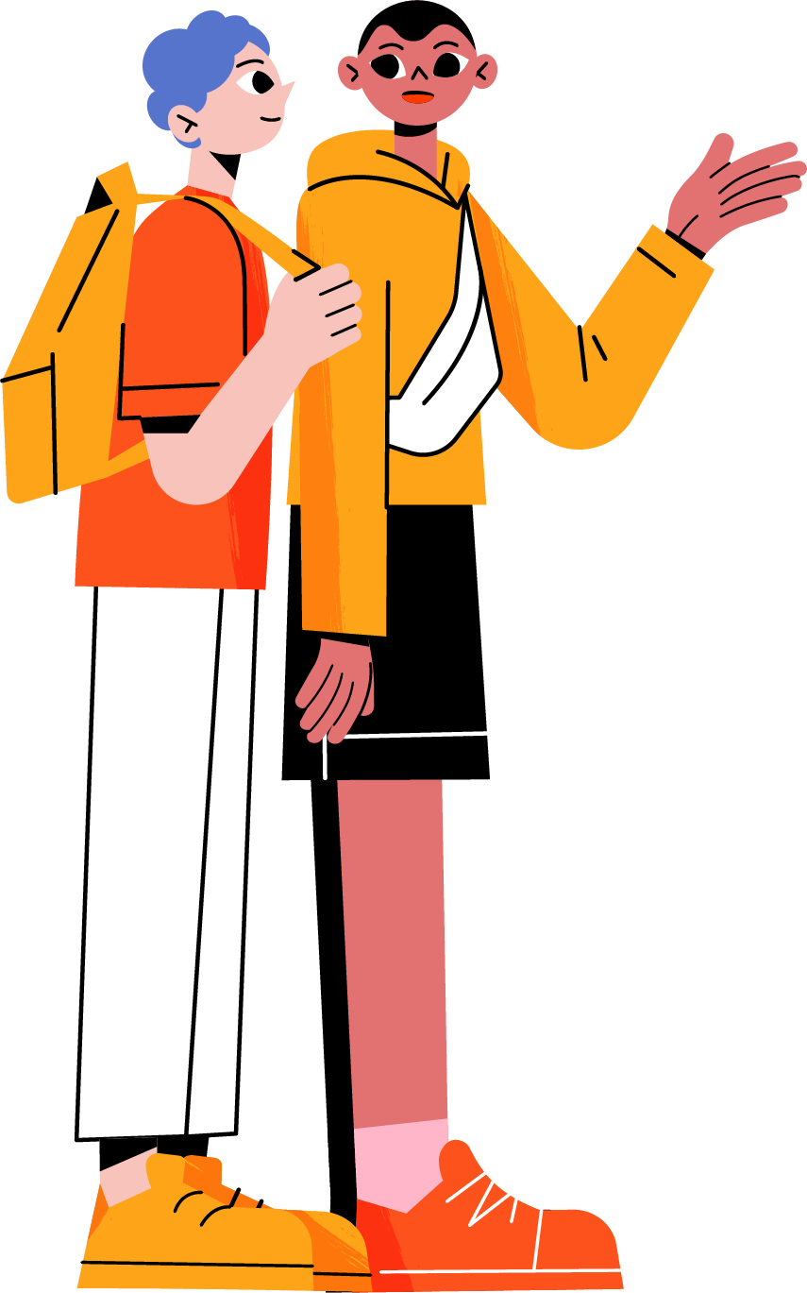
PART 3
How to respond to disinformation?
©Freepik

Slide 16




Part 3: How to respond to disinformation?
Don’t be tricked into reacting!
©Freepik
Pause
©Freepik
Think
Notes:
*Note* - This slide has animation.
Descriptions:
The first step to protecting yourself is to PAUSE – don’t get tricked into reacting to something that might be too good, or too bad, to be true
Don’t be afraid to take some time to think and maybe to investigate the story
Fact-checking can be fun: it’s like playing detective. It’s true that it can take time and you may not always be able to decide for sure if a story is 100% true or false, but you can learn a lot in the process. For example, you can learn about good argumentation techniques or how scientific research is verified.
A lot of disinformation relies on the human tendency to avoid uncertainty
It’s natural to seek certainty, but don’t fall into this trap – take your time and remember that uncertainty is not a sign of stupidity!
When you read a story that stirs up strong emotions…
Pause
Think about it and try to fact-check
Then decide – do you want to share this post, or tell your friends about this story? Do you think you should report it to the social media platform as misinformation? Or maybe you’re still not sure and you’re not going to react for the moment

Slide 17
Part 3: How to respond to disinformation?
When in doubt check
Content
do the title and content match? Does the content make sense?
Outlet / URL
is it reliable? Is it what you think it is?
Author
are they reliable/qualified?
Date
when was it published?
Image
does it actually depict what it says?
Other sources
are other sources reporting on this story? Which ones?
Be aware of your biases!
Think before you share
Notes:
*Note* - This slide has animation.
As an exercise, go back to one of the previous examples (e.g. slide 13 with the video of children allegedly being given guns and joining the army in Latvia).
It’s important to reflect on your own biases. Does this news confirm what you already believe? Would it have made a difference if this news was shared by a friend you like or celebrities you follow…? What sources do you consider trustworthy?.
Check the…
content: Read the whole article – do the content and headline match?
outlet: what other stories does this outlet publish? do they look reliable?
URL: always check if it is the original website or if the URL is built with a slight modification in the name or extension, which can easily be missed. Disinformation sites take the names of well-known news sources, changing small details. For example: nevvyorktimes.com. (EU Disinfo Lab investigation on cloning of legitimate news sites: https://www.disinfo.eu/doppelganger/)
author: often people working in the information industry have websites or other public profiles that can help you find them and their work.
Context
date: sometimes old news stories are reposted on social media because people forget to check the date.
Other sources: do other sources cover the story? do they support claims made in the original article? What kind of sources are they? It can be particularly useful to check reputable international sources (e.g. BBC, Deutsche Welle, France 24). You can use translation tools to access sources in languages other than your own – this can often offer an interesting perspective in general, not just when checking for disinformation.
Think before you share
only share an article if you know it’s genuine – otherwise you might be accidentally spreading misinformation!

Slide 18
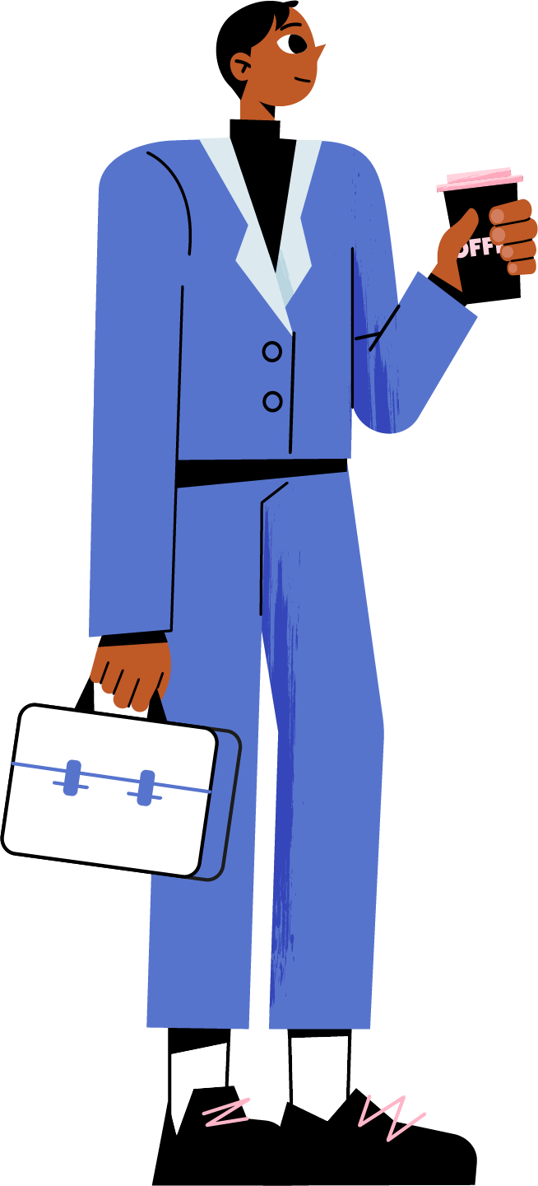
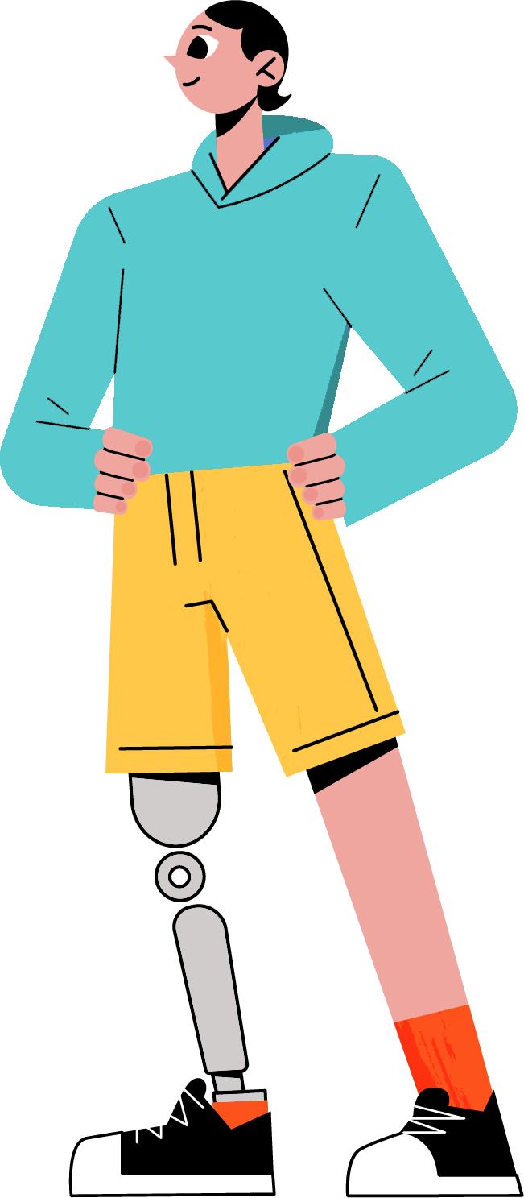
How to respond to disinformation?
3
How can YOU contribute to fighting disinformation?
Don’t believe everything you hear
Raise
awareness
Don’t shame
people
Think critically, check your sources and remember to pause and reflect before reacting.
Share what you’ve learned with friends and family, BUT…
Show empathy and try to understand people who believe disinformation. Confrontation rarely convinces people!
©Freepik
Notes:
The most important thing you can do to help fight disinformation is simply to avoid sharing information that may not be true.
Share the tips you learn in this lesson with friends and family and talk to them about how to avoid being taken in by false or misleading information.
It can be tempting to confront and even shame people for believing information you know isn’t true, but this doesn’t tend to help.
Attacking them will only strengthen their beliefs and may damage your relationship.
Don’t expect immediate change
It might take many conversations and even many years to convince someone. Take your time and don’t lose faith – rather than telling them they’re wrong you can focus on sharing accurate, useful information from reliable sources.

Slide 19
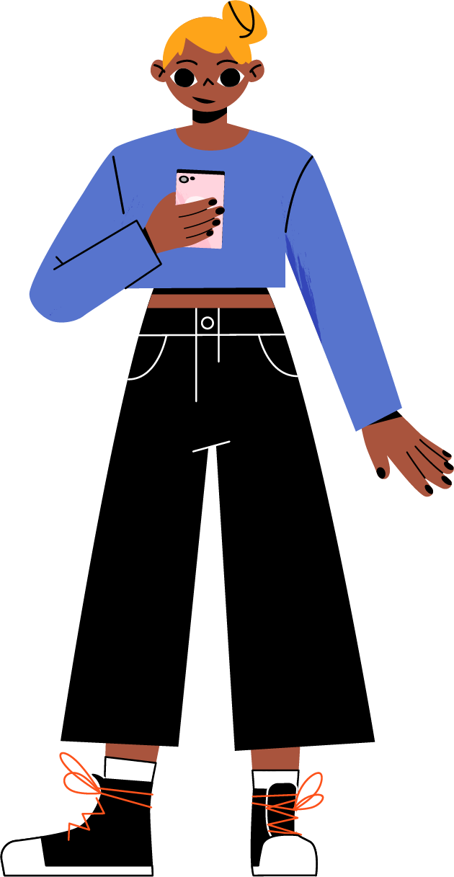
Part 3: How to respond to disinformation?
Fact-checkers
The International Fact-Checking Network provides
a list of fact-checking organisations that have signed up to
the IFCN Code of Principles.
The European Fact-Checking Strandards Network
Search online fact-checks about a topic or person with
Google’s Fact Check Explorer
See debunks of disinformation on EUvsDisinfo.eu
EDMO (the European Digital Media Observatory) monitors and reacts to disinformation through its hubs across the EU.
©Freepik

Slide 20
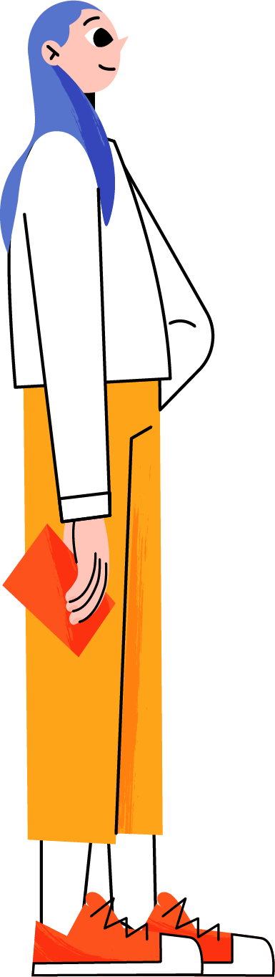
Part 3: How to respond to disinformation?
National fact-checking resources
AUSTRIA and GERMANY | GADMO |  | DENMARK, FINLAND and SWEDEN | NORDIS
BELGIUM and NETHERLANDS | BENEDMO |  | ESTONIA, LATVIA and LITHUANIA | BECID
BELGIUM and LUXEMBOURG | EDMO BELUX |  | FRANCE | DE FACTO
BULGARIA and ROMANIA | BROD |  | HUNGARY | HDMO
CROATIA and SLOVENIA | ADMO |  | IRELAND | EDMO Ireland
CYPRUS, GREECE and MALTA | MEDDMO |  | ITALY | IDMO
CZECHIA, SLOVAKIA and POLAND | CEDMO |  | PORTUGAL and SPAIN | Iberifier
©Freepik

Slide 21


Part 3: How to respond to disinformation?
WHAT IS THE
EU DOING?
Working with social media platforms
(e.g. to minimise the spread of false or harmful information and protect users)
Working with partners
(e.g. EU countries and other countries, international organisations)
Promoting access to information
(e.g. supporting media literacy, independent media and fact-checkers)
Raising awareness and communicating
(e.g. offering reliable info, exposing and preventing disinformation)
Notes:
*Note* - This slide has animations.
The EU is taking action against disinformation in many ways.
- It is cooperating with member countries, with international organisations and with partner countries to find the best approach to stop disinformation from spreading.
It is putting a lot of effort into communicating openly about its plans and the action it has taken. This is important, because if people can access accurate information easily, they are less likely to turn to unreliable sources.
It is monitoring and exposing disinformation and information manipulation, especially on the EUvsDisinfo social media channels and website
It is also supporting media literacy (by funding initiatives and creating hands-on resources like this one) and is also supporting independent media and factcheckers
It is working with social media companies to prevent the spread of disinformation and information manipulation in the EU and to protect users.

Slide 22


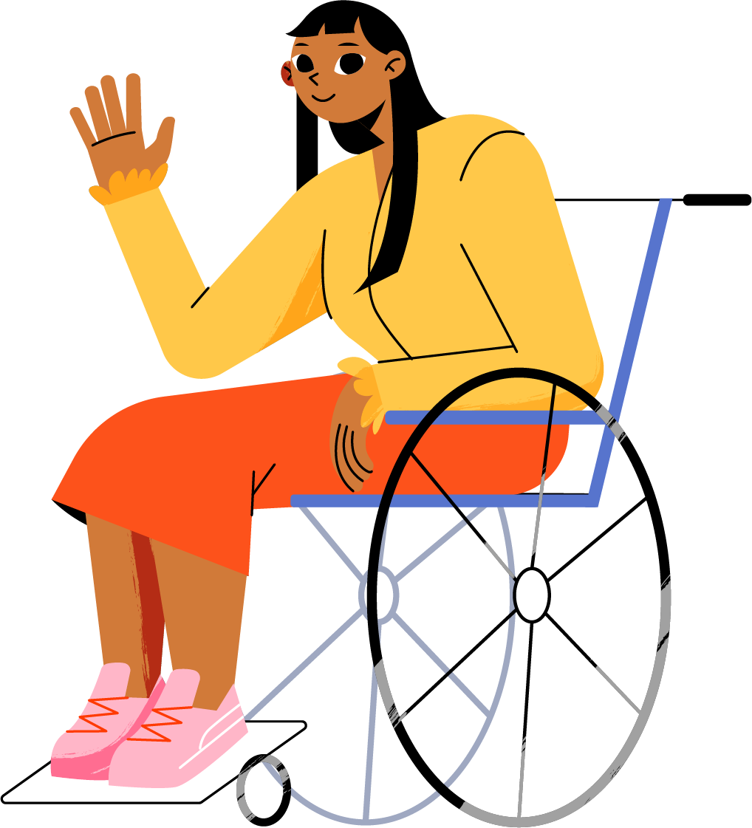
PART 4
Practice
©Freepik

Slide 23

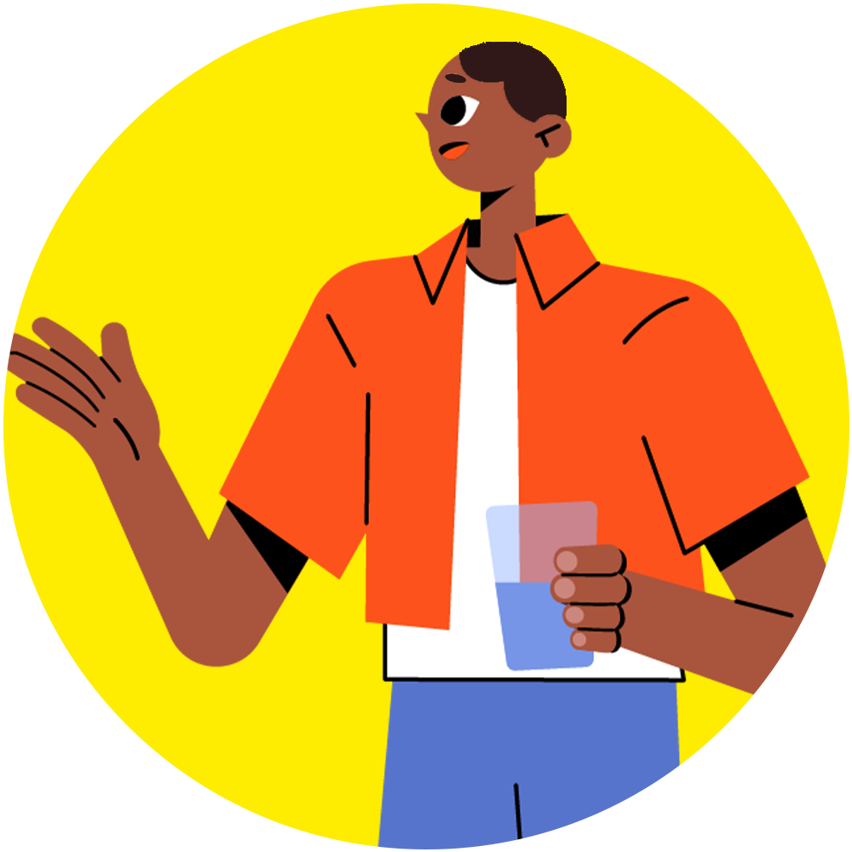
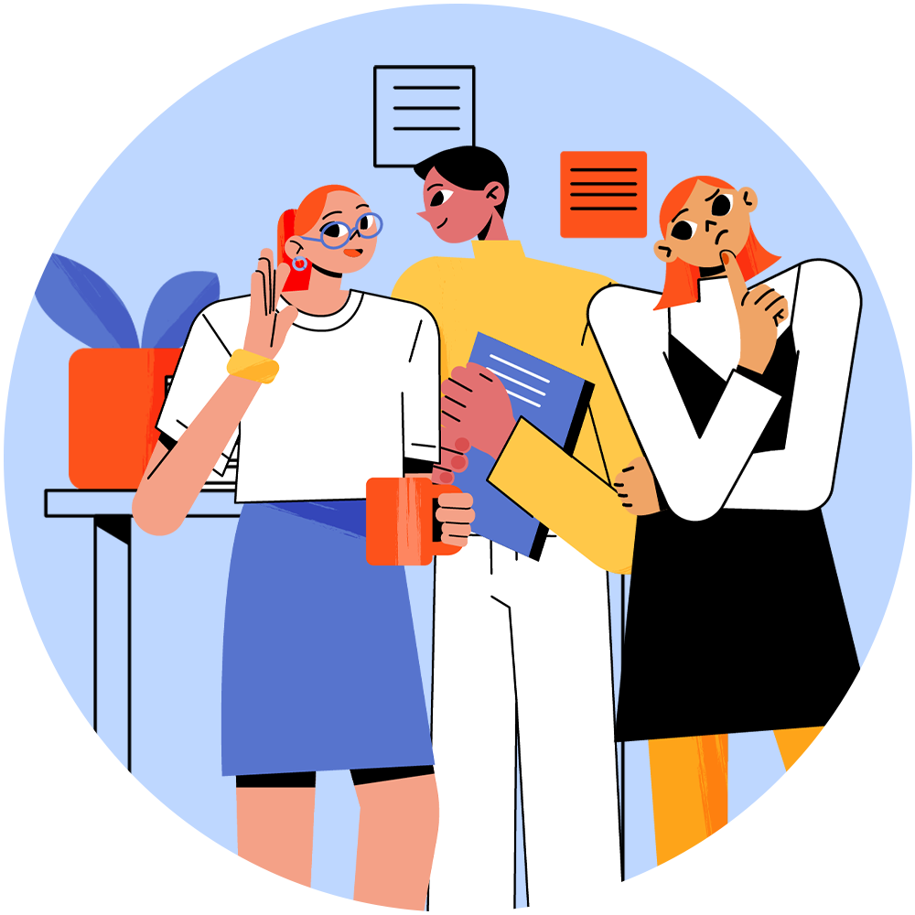





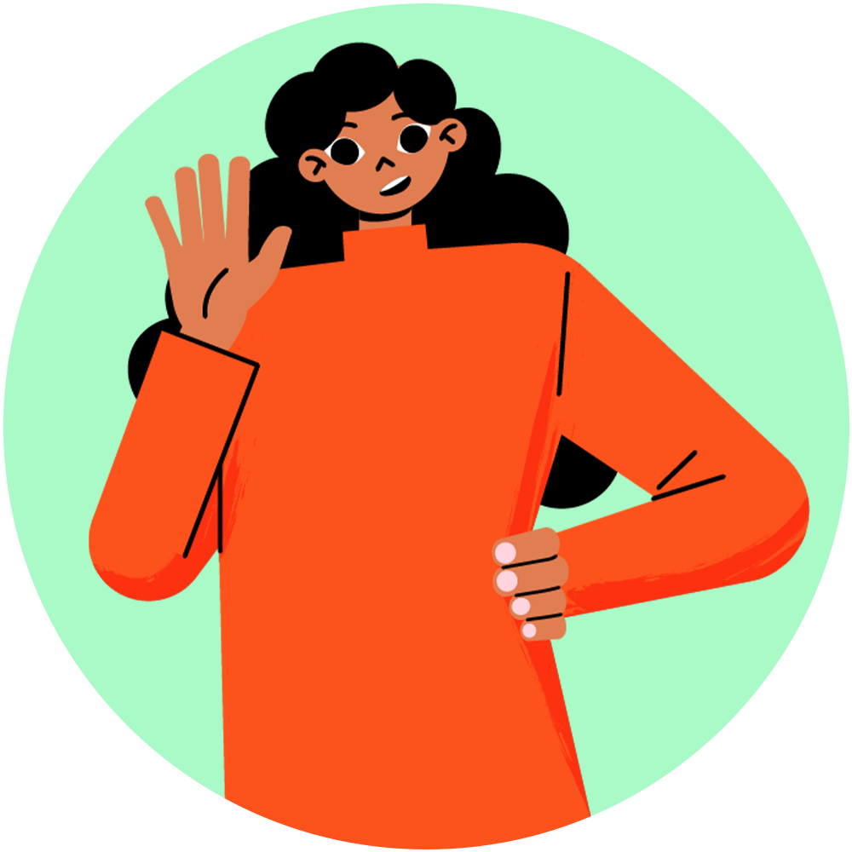
Part 4: Practice
Split into groups
Get your case study & tasks
Prepare a presentation
©Freepik
©Freepik
©Freepik

Slide 24
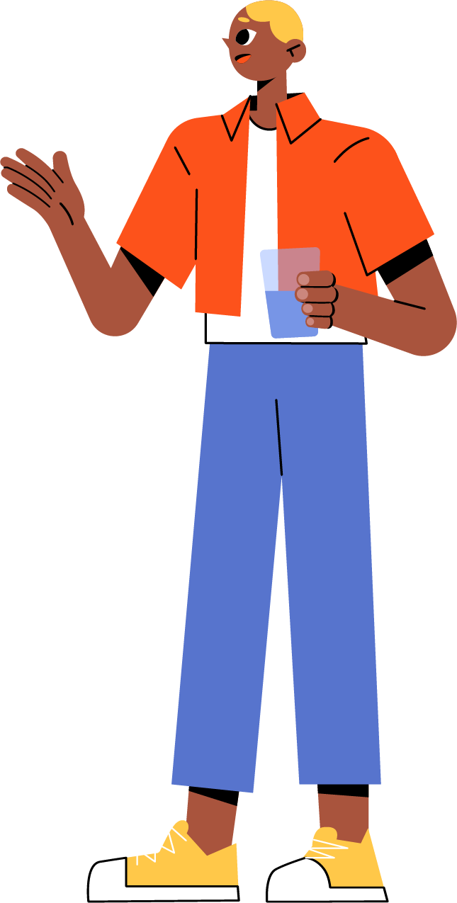
Part 4: Practice
Test what you’ve learned in a game
The Bad News Game
(available in several languages, for age 14 and up), you play the role of someone spreading misinformation online.
Bad News Game for Kids
(available in fewer languages, for age 8 and up)
Cat Park
(English, French, Dutch and Russian; ages 15+), you are given the job of turning the public against a planned park using common disinformation techniques.
©Freepik

Slide 25

Sources:
Illustrations by upklyak on Freepik (slides 1,2,3,7,9,10,15,16,18,19,20,22,23,24)
Slide 4:
  Social media post on encounter between Olivia Rodrigo and Sabrina Carpenter: https://twitter.com/PopBase/status/1521984278057218050?lang=en
  Video on Iron dome being activated: (3) Iran Spectator on X: "⚠️ 𝐁𝐫𝐞𝐚𝐤𝐢𝐧𝐠 𝐍𝐞𝐰𝐬 ⚠️ 🇮🇷| 𝗧𝗵𝗲 𝗦𝗵𝗮𝗵𝗲𝗱 𝗗𝗿𝗼𝗻𝗲𝘀 𝗮𝗽𝗽𝗲𝗮𝗿 𝘁𝗼 𝗵𝗮𝘃𝗲 𝗿𝗲𝗮𝗰𝗵𝗲𝗱 𝗜𝘀𝗿𝗮𝗲𝗹 𝗿𝗶𝗴𝗵𝘁 𝗻𝗼𝘄 Video confirmation has been provided: https://t.co/5Mt7VfstLB" / X (twitter.com)
  Fake Forbes Magazine cover: https://u.afp.com/5Arh
Slide 6: Image of the Pope Francis on the left ©Pablo Xavier, image of the Pope Francis on the right © Mazur/catholicnews.org.uk
Slide 8: StopFake: https://www.stopfake.org/en/russian-disinfo-patterns-same-actors-different-sets/ , Images Source – vesti-ukr, stopfake.org, stopfake.org, YouTube.
Slide 11:
  https://www.euronews.com/2022/09/01/un-report-slams-china-for-torture-and-sexual-violence-in-xinjiang
  https://www.bbc.com/news/world-asia-china-57780023
  https://apnews.com/article/china-tiktok-facebook-influencers-propaganda-81388bca676c560e02a1b493ea9d6760
  https://www.youtube.com/watch?v=TydmPS8dDGc
Slide 12:
  Image of newspapers ©Adobe Stock
  Image of 5G: https://www.nytimes.com/2019/05/12/science/5g-phone-safety-health-russia.html
Slide 13: https://www.youtube.com/watch?v=nOd2vMCDv9M&feature=youtu.be
Slide 14: https://youtube.com/shorts/FeHzQizPDNg?feature=shared
© European Union 2024
Unless otherwise noted the reuse of this presentation is authorised under the CC BY 4.0 license. For any use or reproduction of elements that are not owned by the EU, permission may need to be sought directly from the respective right holders.

Slide 26
End of presentation

