Slide 1




Desinformation
ENTLARVE UND BEKÄMPFE

Slide 2



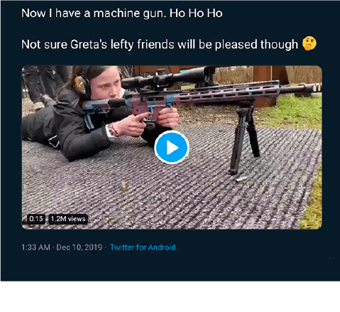

BEISPIELE
JEMAND TWEETET:
JEMAND POSTET AUF FACEBOOK:
Greta am Maschinengewehr!
Der Papst unterstützt einen Politiker!
Notes:
Which one is fake?
Ice-breaker: Let’s start with an easy example that probably won’t fool anyone, but might make you laugh.
Source: www.snopes.com
2

Slide 3
BEISPIELE
IRREFÜHREND
QUELLE EXISTIERT NICHT
FAKE
FAKE
Das Foto hat ursprünglich eine andere junge Frau gepostet, die aus dieser Perspektive Ähnlichkeit mit Greta hat.
Dailypresser.com ist kein echtes Nachrichtenportal. Der Post ist frei erfunden.
Notes:
Sometimes hard to tell the difference between true and false
Solutions: both fake
Deceptive story: a climate activist with a gun? The picture belongs to another person who, from that particular angle seems to be Greta Thunberg (Source: www.snopes.com and https://factual.afp.com/el-video-de-una-mujer-disparando-no-muestra-greta-thunberg-sino-una-ingeniera-sueca)
Invented news: The story is not true and the news source (dailypresser.com) simply does not exist
3

Slide 4





AUFBAU DER LERNEINHEIT
DESINFORMATION VERSTEHEN
2
1
GRUPPENARBEIT
FALLBEISPIELE
3
ZUSAMMENFASSUNG UND WEITERFÜHRENDE TIPPS
PRÄSENTATIONEN
UND DISKUSSION
4
Notes:
Understanding disinformation – slide 4-24
Work in group – slide 25
Presentation & Discussion slide 25
Summary & Tips for finding out more – slide 26-34
4

Slide 5


DESINFORMATION VERSTEHEN
Was
ist Desinformation?
Wie
Beispiele
funktioniert Desinformation?
Beispiele
Wie
sollten wir mit Desinformation umgehen?
Empfehlungen zum Umgang
Notes:
We will talk about definitions, techniques and offer some advice on how to easily spot disinformation, protect yourself from it and help others become more vigilant too!
5

Slide 6

1
WAS IST DESINFORMATION
AUSLÄNDISCHE EINMISCHUNG
EINFLUSSNAHME
DESINFORMATION
FEHLINFORMATIONEN
FAKTEN
MEINUNGEN
SATIRE UND HUMOR
WAS SIND FAKTEN
WAS IST FIKTION
Notes:
WHAT IS DISINFOMATION
Learning objectives:
start with definitions and be able to distinguish between the concepts
assess the dangers of each case study and how it could be used as a disinformation narrative
stress importance of values: promotion of media freedom and pluralism, respect for fundamental rights like freedom of expression, no ‘Ministry of Truth’
Ask the pupils if they know what disinformation is. Check the pupils’ examples against the definition. Could some of them have been disinformation?
If not, what are they? (For instance, unpleasant news or opinions, marketing, mistakes or misunderstandings.)
Opinion or fact? Draw a distinction between opinion and fact.
What is a fact? Facts can be checked and backed up with evidence.
What is an opinion? Opinions are based on a belief or point of view, not on evidence that can be verified. Some people might think it is the opposite.
Suggested (optional) activity: Ask the students to go through a newspaper piece and highlight parts that are opinions, verify those that are facts with a reliable source, and the ones that seem like facts, but do not mention sources. Ask the class to share its findings.
False information is everywhere but it’s important to distinguish disinformation from other types of false information, namely misinformation, based on the INTENTION:
Disinformation is false information that’s created and shared to deliberately cause harm. Example: a tweet about migrants committing crimes in Europe, designed to divide society.
Misinformation is false information that’s shared by people who don’t realize it’s false and don’t mean any harm. Often they’re just trying to help. Example: when your aunt shares an article or meme on Facebook claiming that garlic protects from COVID-19 because she thinks it’s useful information without realizing it’s false.
Influence operations - coordinated efforts to influence a target audience using a range of illegitimate and deceptive means, in support of an adversary’s objectives
Foreign interference - coercive, deceptive, and/or clandestine efforts by a foreign state actor or its agents to disrupt the free formation and expression of political will, during elections, for example
Pupils might also be familiar with the term ‘fake news’, but we don’t recommend using it. When politicians blame independent journalists for publishing ‘fake news’ while they are simply being critical, something is wrong. We don’t want the term ‘fake news’ to result in delegitimizing the media.
6

Slide 7

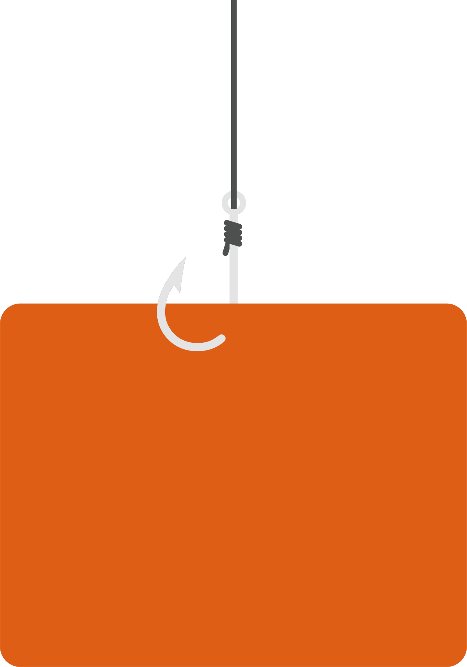
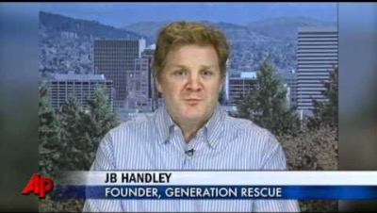
WAS IST DESINFORMATION - DIE BEWEGUNG DER IMPFGEGNER
1
Falsche Schlussfolgerungen, Irreführung der Gesellschaft
Schuldzuweisung, wahre Ursachen von
Autismus außer Acht gelassen/nicht untersucht
Langfristige Folge:
niedrigere Impfrate führt zu Massenepidemie
Notes:
Start by playing the video on the slide (https://www.youtube.com/watch?v=d8uRYqsu2W4)
Total time: 1 min 40 sec
Transcript:
---------------------------
(voiceover)
For millions of families dealing with autism it was a possible answer for their struggles. A landmark medical study, linking children’s vaccinations with the disorder. But that study is now being called 'misleading' with some even saying it’s an elaborate fraud.
(Fiona Godlee, Editor, British Medical Journal)
We’ve known from the start that the study was a poor study. It got an enormous amount of media attention. All of the evidence, all of the epidemiological studies, the ones looking at blood populations of children have countered this and said there is no evidence of the link.
(voiceover)
It was a paper by Andrew Wakefield and his colleagues in 1998 that scared patients prompting immunisation rates around the globe to drop. Wakefield claimed 12 children were normal until they got the common vaccine for measles, mumps, and rubella.
But his paper was later retracted, and a new examination found that Wakefield and his colleagues altered facts about patients in their studies. But Wakefield still has his supporters – Jamie Handley is one of them, he is the father of an autistic son.
(JB Handley, Founder, Generation Rescue)
Vaccines are known to cause brain injury, so it doesn’t take a rocket scientist to think: they took the kid for an appointment, they were normal, they came out, they were suffering dramatically. And these things cause brain injuries to some kids. That’s why we’re all still here and the real science has never been done.
(voiceover)
Wakefield was stripped of his right to practice medicine in Great Britain last May. Since then other studies have shown no connection between the MMR vaccination and autism.
Wakefield could not be reached for comment. Rosenson, the Associated Press.
---------------------
Speaking points:
Society requires people in academic institutions to follow high academic standards, so it is important to understand why those are necessary. This one single academic paper, which was disproven and debunked many times, is one of the biggest reasons the anti-vaccine movement was created and is still prevalent today. Even though the paper was wrong, it got enough media attention to damage the public perception of vaccines, which have repeatedly been shown to be safe and effective.
Everybody has a right to free speech, but is not the same as having the right to deliberately spread lies, especially when they can do damage to public health.
Why it’s bad:
People are eager “to quickly connect the dots” even when the connections they make contradict scientific insights.
Transferring guilt helps to obscure potential factors like individual responsibility or proven causes for the development of autism. For example, autism is usually diagnosed around the same time that the MMR vaccine (i.e. measles vaccine) is given to children. This fact is usually ignored by people who would rather believe their child was given autism than accept that the diagnosis was out of their control.
When spread broadly, this fake story risks becoming a game changer for the vaccination system. Large numbers of people could needlessly lose their immunity to serious diseases.
7

Slide 8


1
WAS IST DESINFORMATION - DIE STORY: 5G IST AN CORONA SCHULD
MEINUNGSFREIHEIT
BESCHÄDIGUNG VON 5G-MASTEN
SKEPSIS HINSICHTLICH
GESUNDHEITLICHER FOLGEN
TELEKOMMUNIKATIONSNETZ
FÄLLT AUS
FALSCHE VERKNÜPFUNG
VON COVID-19 MIT
NETZTECHNOLOGIE
Notes:
Since the beginning of the COVID-19 pandemic, much confusing information has spread on social media, with many claiming a link between 5G technologies and the spread of coronavirus. On the one hand, everyone has the right to express themselves freely, and it’s not bad to be cautious or even skeptical about new technologies and the effect they can have on our lives and health.
BUT this theory has brought harmful consequences in the real world, such as the burning down of telecommunications infrastructure, and physical attacks on workers installing the infrastructure.
Why it’s bad:
Real-life destruction: arsonists setting fire to cell towers across Europe
Failure of telecommunications networks, as many of the towers destroyed and vandalized were for 3G and 4G service, which the public depends on
Telecoms employees harassed on the street for laying down 5G fiberoptic cable or any other type of telecommunications infrastructure.
“When people feel threatened or out of control or they’re trying to explain a big significant event, they’re more vulnerable or prone to turning to conspiracy theories to explain them. Somewhat counterintuitively, it gives people more sense of control to imagine that, rather than random things happening, there are these shadowy groups and agencies that are controlling it. Randomness is very discomforting to people.” John Cook, expert on misinformation at George Mason University’s Center for Climate Change Communication
8

Slide 9

1
WAS IST DESINFORMATION - HEIẞWASSER TÖTET CORONAVIREN AB
LENKT DAVON AB, WAS WIRKLICH
HILFT
(Händewaschen / Abstandhalten / Maske)
HEIẞWASSER ZU TRINKEN,
SCHADET
DER GESUNDHEIT NICHT
TRÜGERISCHES SICHERHEITSGEFÜHL
GEGENÜBER CORONA
ANGST UND VERUNSICHERUNG
WERDEN GENUTZT,
UM UNWISSENSCHAFTLICHE
INFORMATIONEN ZU VERBREITEN
Notes:
Talking points:
- Using inappropriate health advice can induce people to not get cured, or to underestimate or overestimate a certain illness. This image in the context of covid 19 is a good example. This is the original that some of you might have seen on social media or even on some of your WhatsApp conversations: https://factcheck.afp.com/gargling-warm-salt-water-or-vinegar-does-not-prevent-coronavirus-infection-health-experts-say
Why it’s bad:
In this case, telling people to drink hot water is not very dangerous, but what if the disinformation was about drinking a liquid that is actually very dangerous to us, like bleach?
In fact, a study in the American Journal of Tropical Medicine and Hygiene showed that disinformation and misinformation about the coronavirus has led to the deaths of at least 800 people and possibly more (as of August 2020), as well as the hospitalization of around 6,000. The study examined COVID-19 related rumours, stigmata and conspiracy narratives circulating online and their impact on public health.
Often this false information is spread unintentionally but in many other cases it is spread by sources trying to generate clicks from headlines and stories carefully crafted to attract attention (‘clickbait’ journalism e.g. “Scientists are saying that this ancient remedy could be the answer to curing cancer. Click here to read more!”) or even malicious actors trying to sow chaos, confusion and pollute the information environment with many, often conflicting, narratives.
9

Slide 10
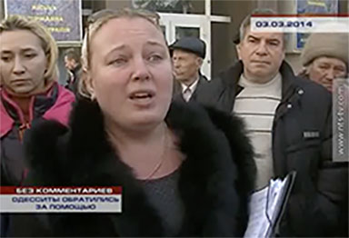
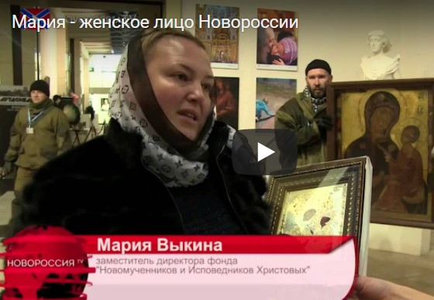
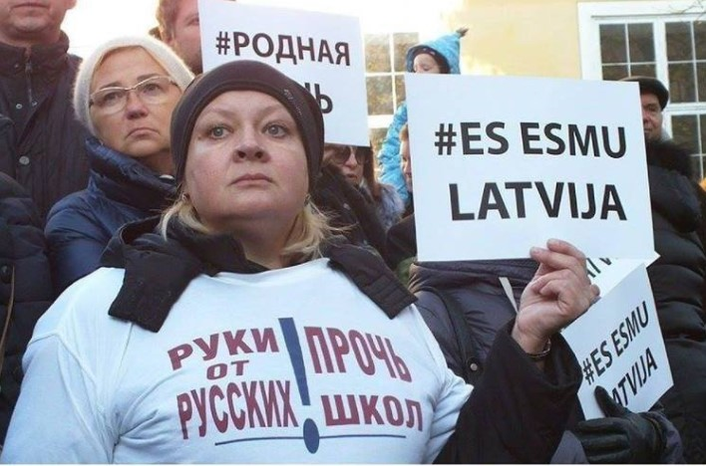
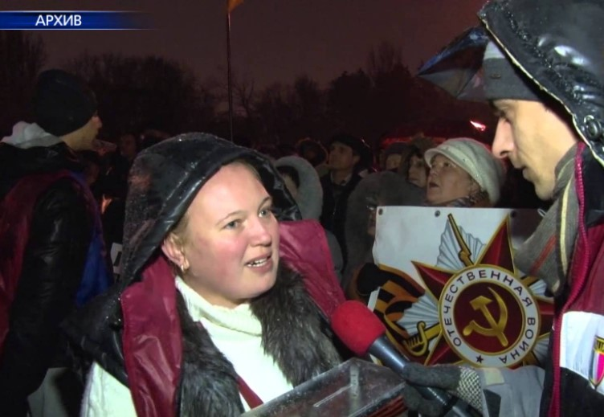
1
WAS IST DESINFORMATION - EIN UND DIESELBE PERSON SPIELT VERSCHIEDENE ANTI-UKRAINISCH EINGESTELLTE CHARAKTERE
Ich bin Maria, Mutter und Einwohnerin der Krim
Hier bin ich stellvertretende Vorsitzende
einer Kulturstiftung
in Lugansk
Hier bin ich eine russischsprachige Einwohnerin von Riga in Lettland
Hier lebe ich
in Charkiw in der Ukraine
SCHAUSPIELERIN SPIELT CHARAKTERE IN EINER FAKE STORY
Notes:
Start by playing the video on the slide (https://www.youtube.com/watch?v=9jnq3MRLsEU)
Total time: 40” (from 2min51sec to 3min31sec)
Transcript (translated):
---------------------------
(Maria, she calls herself an Odessa resident who came to the rally in Sevastopol, Crimea on March 3rd, 2014)
(the excerpt is from NTS – Crimean TV station broadcast as a report from the public rally)
//
Teachers from the school are calling and ask for protection.
My children learn at Russian school and I am on the parents’ board.
When I come to school and children ask “Will we too go to prison now for learning the Russian language and talking in Russian?”
In order to reach you we had to switch off our cell phones, took batteries out.
The huge persecution started – it is truly horrible.
---------------------------
//
Various videos with the same participants:
https://www.youtube.com/watch?v=Onui6ivzf4o (Kharkiv)
https://www.youtube.com/watch?v=9jnq3MRLsEU (Sevastopol)
https://www.youtube.com/watch?v=mYlDRUnzvsc (“referendum” in Crimea)
https://www.youtube.com/watch?v=3YM-Og-g_jY (Kyiv)
https://www.youtube.com/watch?v=x4jWXVQ-Jog (Lugansk) > video unavailable
https://www.youtube.com/watch?v=JzcBu28nqV0 (Krivoy Rog)
Speaking points:
- Propaganda authors must be sure that their message is consistent, so professional actors are used to impersonate various emotionally moving characters
- Using real examples would not appear that radical, so the arguments would be balanced and the final impact for the viewer would be objective. Instead, here we have manufactured hatred against the cause of Ukrainian independence and its supporters
Why it’s bad:
Fake information is used to vilify opponents, no matter what the facts on the ground are.
An extreme (false) description of the situation is portrayed as real and so incites a vengeful response
Emotional manipulation uses various social groups as an indirect argument for supporting “extreme counter-measures”
10

Slide 11


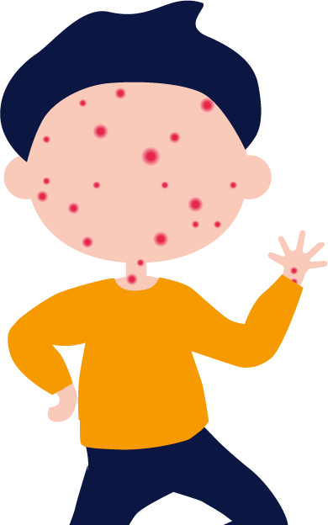
2
SO FUNKTIONIERT DESINFORMATION - PROZESS DER DESINFORMATION I
GLAUBEN
UNTERSTÜTZEN
HANDELN
Notes:
HOW DISINFOMATION WORKS
Learning objectives
Understand the main actors, behaviours and content that define disinformation
Understand that those who spread disinformation often try to intentionally evoke emotional responses from readers
Understand that we are all at risk from disinformation; discuss the reasons why it’s dangerous.
Descriptions:
- When do we start believing something and when are we ready to go an extra mile to support something?
- Disinformation is a process - It does not happen quickly:
- Fake research report linking measles vaccine with autism was published in 1998 → Fake research fuels fears against vaccination, which results in increase of the measles disease
- Motivation to support an idea/cause for political or financial gain
- Students are encouraged to reflect how no real debate can happen unless everyone can make informed choices based on facts; while all opinions are acceptable, spreading lies is not.
11

Slide 12








2
SO FUNKTIONIERT DESINFORMATION - PROZESS DER DESINFORMATION II – DIE EUROPÄISCHEN WERTE
EUROPÄISCHE WERTE
IN VIELFALT
GEEINT
Notes:
Speaking points:
Exaggerating differences is a tool for weakening a community
It is more difficult to undermine a strong community that unites behind its shared values and its common identity
12

Slide 13
2
SO FUNKTIONIERT DESINFORMATION - PROZESS DER DESINFORMATION II – DIE EUROPÄISCHEN WERTE
Misstrauen und
Argwohn nehmen zu
Vertrauen in Werte wie Demokratie und Gleichstellung geht langsam verloren
EUROPÄISCHE WERTE
IN VIELFALT
GEEINT
Notes:
Therefore disinformation is used to divide people and exaggerate internal differences
Providers of disinformation want to polarize our societies and promote “us vs them” narratives
When former friends are divided, it is much easier to fight each small group separately
But much of the progress in civilisation lies in finding compromises between the interests of different groups
13

Slide 14
2
SO FUNKTIONIERT DESINFORMATION - PROZESS DER DESINFORMATION II – DIE EUROPÄISCHEN WERTE
ES HERRSCHEN VERWIRRUNG, ZAUDERN, UNENTSCHLOSSENHEIT
ANTIEUROPÄISCHE WERTE FASSEN FUẞ
EUROPÄISCHE WERTE
IN VIELFALT
GEEINT
Notes:
We are all at risk of falling prey to disinformation. It is a dangerous phenomenon that can:
- spread mistrust in public institutions, which can lead to political apathy or radicalization.
- spread mistrust in scientific and medical information, which can have serious health consequences.
14

Slide 15
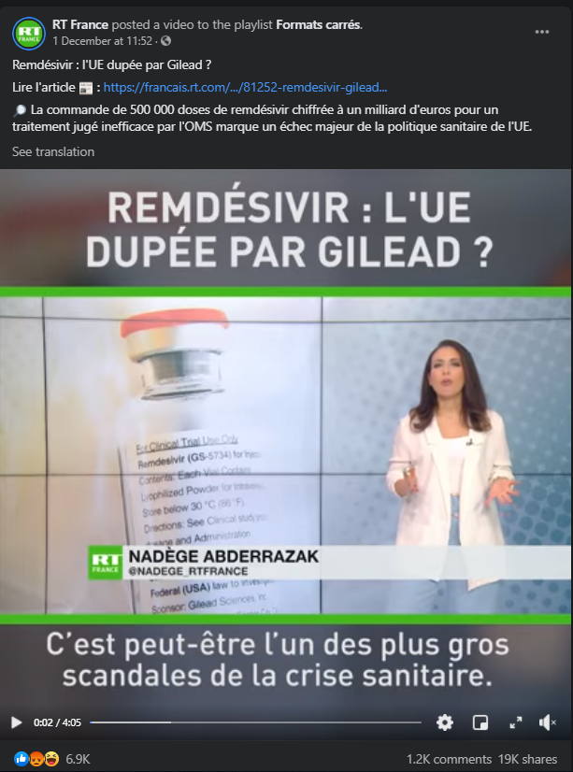
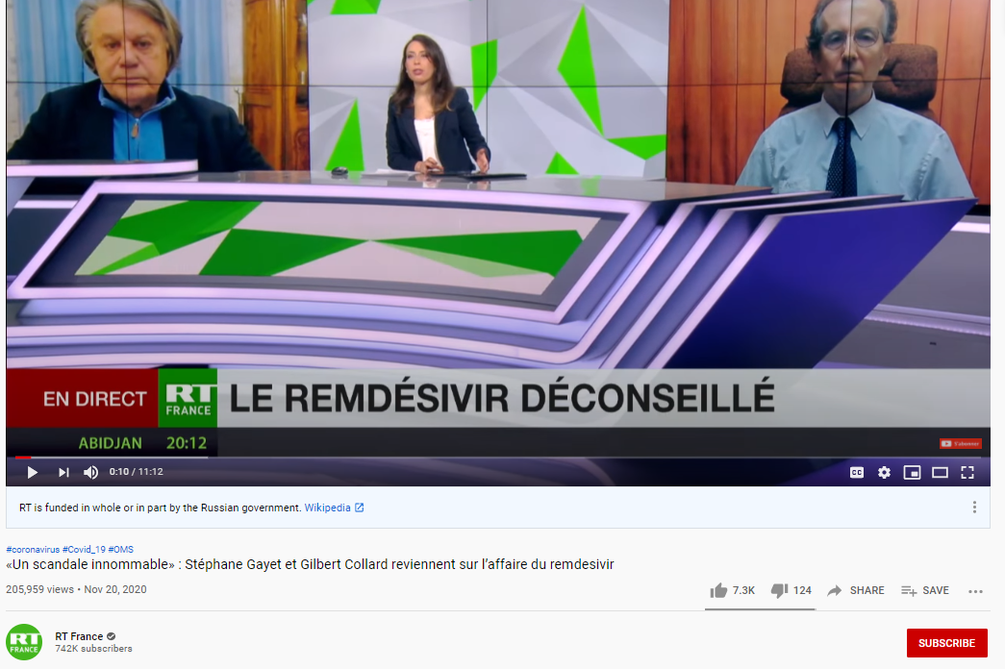
2
SO FUNKTIONIERT DESINFORMATION - PROZESS DER DESINFORMATION II- KAMPAGNE GEGEN DIE EU: VON RUSSIA TODAY
Notes:
State-controlled media like Russia Today are ‘usual suspects’ among the purveyors of disinformation, especially with the aim of sowing distrust and creating division within the EU and the West. A common tactic of actors who spread disinformation, specifically those linked to the Kremlin, is to sow distrust in democratic institutions and seek to undermine the European Union by deliberately crowding the information space with false narratives. In the examples here, the coverage by Russia Today centers on Remdesivir, which was authorised in the EU in July 2020 for the treatment of COVID-19 in adults and adolescents from 12 years of age with pneumonia who require supplemental oxygen. Pro-Kremlin media have promoted multiple deceptive stories on the EU buying large stock of Remdesivir, which was allegedly deemed as an ineffective treatment by the WHO. The stories described this move as a major failure of EU health policy and “of the greatest scandals of the health crisis”. In reality, according to WHO, the certainty for their results is low and the evidence did not prove that Remdesivir has no benefit. The recommendation is conditional, which is issued when evidence around the benefits and risks of an intervention are less certain.
This is a widely used method by malign actors who spread disinformation for political and financial gain: the goal is more often than not to undermine the EU/the West by presenting its policies and values as failed ones, therefore eroding the public’s trust in institutions and authorities involved in those decisions. By amplifying information like the story above, disinformation actors create more confusion during an already uncertain situation, leading the public to often ignore the guidance of national authorities and scientific experts.
Source: https://www.youtube.com/watch?v=e7jiPDxxx3o&ab_channel=RTFrance
https://www.who.int/news-room/feature-stories/detail/who-recommends-against-the-use-of-remdesivir-in-covid-19-patients
https://www.ema.europa.eu/en/news/update-remdesivir-ema-will-evaluate-new-data-solidarity-trial
15

Slide 16
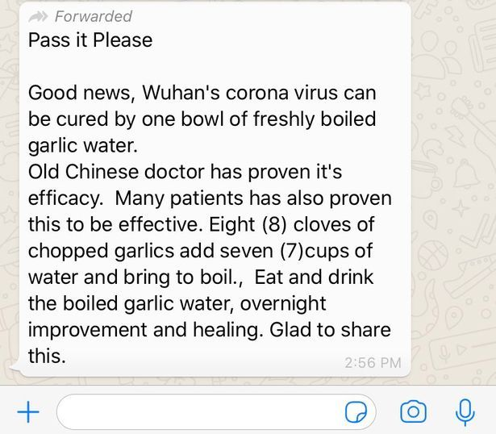
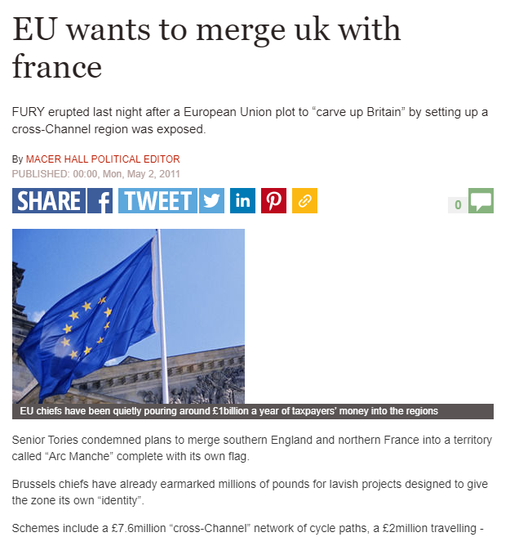
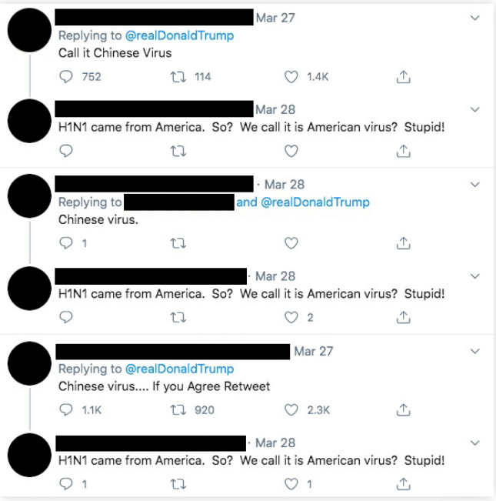
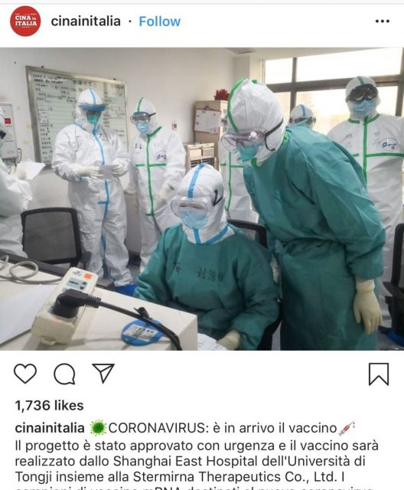
2
SO FUNKTIONIERT DESINFORMATION - PROZESS DER DESINFORMATION II – DIE EUROPÄISCHEN WERTE
Notes:
Whether the objective of those spreading a specific disinformation narrative is political or financial gain, social media plays a tremendous role in amplifying or stopping disinformation from spreading. Speak about:
Social media is used by everyone, including us and everyone we trust, like our friends and family. That’s why we have to be extra vigilant with information we see/receive. See above an example of a WhatsApp message containing entirely false information on a bogus coronavirus cure. (left)
Clickbait (generating profit from clicks) > making headlines or images/videos intentionally appealing and mysterious to get more clicks. Remember the ‘Pope endorsing Trump’ article from earlier? See also example above of EU allegedly wanting to merge UK with France. (middle – top)
Completely fabricated stories like the one above of an Instagram post from April 2020 claiming to have found the vaccine for coronavirus, while no such vaccine existed at the time and no advanced research for it had began (middle – bottom)
Artificial amplification > getting a story or a narrative to go viral through inauthentic means: fake profiles and bots, storming posts with comments and shares to give it more traction. Profiles created to intentionally look like ‘everyday’ people with descriptions about normal jobs and hobbies but operated entirely artificially or by troll factories. The example above shows replies to different Twitter accounts’ posts, using similar narratives or identical text, which suggests coordinated messaging. Source: Report by Institute for Strategic Dialogue and Alliance for Securing Democracy - https://www.isdglobal.org/wp-content/uploads/2020/08/ISDG-proCCP.pdf
Out of context use of imagery: we’ll see an example in the next slides. A very common disinformation technique is to re-use older footage (often graphic or shocking) for a current event, or in entirely different contexts.
More info: https://www.cits.ucsb.edu/fake-news/spread
16

Slide 17

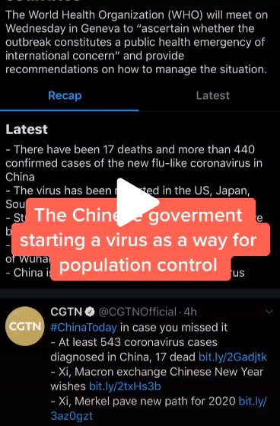
2
SO FUNKTIONIERT DESINFORMATION - DIE ROLLE DER SOZIALEN MEDIEN
DIE ROLLE DER SOZIALEN MEDIEN
Notes:
TikTok, the short-video app, has seen an incredibly rapid increase in its base of users especially among teenage audiences. But as its popularity grew in Europe and in the United States, TikTok also became host to a wide range of false content, much of it political, as well as anti-vaccination posts and misinformation surrounding climate change, such as attacks on Swedish environmental activist Greta Thunberg.
Earlier this year, there were multiple videos on TikTok spreading baseless claims and debunked conspiracy theories about the coronavirus outbreak.
Videos like the one pictured here, with thousands of combined views made claims that “the Chinese government” was “starting a virus as a way for population control” or claiming the outbreak was “really a government biochemical attack” to distract people. Another video said that “people are convinced that China decided to release the virus by ‘accident’ ... as a way of controlling population.”
Since then, TikTok has developed clear guidelines against misleading information on their platform, including medical misinformation, but anyone who uses the app knows how quickly new trends, hashtags, challenges can start and spread so it’s important to be vigilant when viewing and sharing that content.
Sources: https://www.poynter.org/fact-checking/2019/misinformation-makes-its-way-to-tiktok/
https://www.mediamatters.org/fake-news/tiktok-hosting-videos-spreading-misinformation-about-coronavirus-despite-platforms-new
17

Slide 18

2
SO FUNKTIONIERT DESINFORMATION - WIE LASSEN SICH INHALTE MANIPULIEREN?
Notes:
Watch this video very closely – it looks very real, right? Unsurprisingly though, the Pope did not perform a tablecloth trick when visiting the United States and this clip is entirely fabricated: it’s what we call a ‘deep fake’. Here is a comparison with the original version: https://www.youtube.com/watch?v=ABy_1sL-R3s&feature=emb_title
Deep fakes are today’s version of Photoshop: they use artificial intelligence to create new footage (images, videos, voice recordings) that depicts events, statements or action that never actually happened. The results can be quite convincing. Deepfakes differ from other forms of false information by being very difficult to identify as false. Deepfakes are fake videos created using digital software, machine learning and face swapping.
For more information, please read here: https://www.betterinternetforkids.eu/web/portal/practice/awareness/detail?articleId=5398982#:~:text=Deepfakes%20are%20computer%2Dcreated%20artificial,action%20that%20never%20actually%20happened.&text=Deepfakes%20are%20fake%20videos%20created,machine%20learning%20and%20face%20swapping.
18

Slide 19

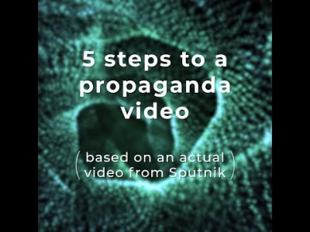
2
SO FUNKTIONIERT DESINFORMATION - WIE LASSEN SICH INHALTE MANIPULIEREN?
Notes:
Another example of using imagery out of context to construct a false narrative is this Sputnik story about children in ‘militarized’ Latvia getting indoctrinated by NATO: https://www.youtube.com/watch?v=nOd2vMCDv9M&feature=youtu.be
Let students reflect about their emotions. What do they feel when they see this? How would they react if this appeared in their news feed on Instagram/Tiktok? Why do they feel emotional about this? The news in itself, the way it is formulated, the picture…?
Introduce the next chapter: responding to disinformation
19

Slide 20




3
DER UMGANG MIT DESINFORMATION
Denk nach,
Mach Meldung an
bevor du Inhalte teilst
die Plattformen
Werde persönlicher Faktenprüfer für deine
Faktencheck
Familie und Freunde
Notes:
HOW TO RESPOND TO DISINFORMATION
Learning objectives:
Understand that we all have a role to play in stopping disinformation from spreading, because it puts our democracies (and potentially our lives) at risk
Discuss the different steps for assessing the veracity of content, including being thoughtful before sharing and key elements in the process of fact-checking
Learn how to talk to others about disinformation and its dangers, and stop them perpetuating harmful and false narratives
20

Slide 21

3
DER UMGANG MIT DESINFORMATION - DENK NACH, BEVOR DU INHALTE TEILST / FAKTENCHECK
Zweifeln
Faktencheck
Entscheiden
Notes:
Descriptions:
Being aware of disinformation and the fact that you can be a target is a first step towards protection.
Fact-checking is a good 2nd step and can also be fun: it’s like playing detective and the pupils could really enjoy it. It’s true that, most of the time, it is quite time-consuming, but the students shouldn’t feel discouraged because often particular features of a piece of information already reveal a lot about the quality of the message conveyed.
You should always look at information with a critical attitude.
How to foster trust towards institutions and the media?
What would happen if, in time of crisis, we did not believe what our authorities tell us to do?
What’s important is the source - it’s good to maintain a certain level of skepticism, but it’s especially important if the source is not a reliable one.
21

Slide 22

3
DER UMGANG MIT DESINFORMATION - FAKTENCHECK
Faktencheck bei Zweifeln
Prüfe die Inhalte
Werde Myth Buster
Prüfe das Publikationsmedium
Hinterfrage die eigene Voreingenommenheit
Prüfe den Verfasser
Denk nach, bevor du Inhalte teilst
Prüfe die Quellen
Prüfe die Bilder
Notes:
As an exercise, go back to one of the previous examples (e.g. video of children allegedly being given guns and joining the army in Latvia, or fake image of COVID-19 vaccine being invented).
Let the pupils reflect about their own bias. Do they feel this news confirms what they already believe? Would it have made a difference if this news was shared by a friend they like/ celebrities they follow…? Discuss how they can check if this is true (the steps of the compass): check the content/ outlet/ author/ sources/ pictures/ myth busters. Let them reflect on what is a trusted source and what not. THINK BEFORE YOU SHARE!! Show video of EUvsDisinfo as inspiration: https://www.facebook.com/watch/?v=3192621760756370; https://www.facebook.com/watch/?v=2584252091848910
In more detail:
Read the whole article – do the content and headline match?
How can I verify the reliability of a website? URL analysis: always check if it is the original website or if the URL is built with a slight modification in the name or extension, with the idea that a distracted or hasty reader would not notice. Disinformation sites take the names of well-known news sources, changing small details. For example: (from the slide at the beginning) dailypresser.com, or nevvyorktimes.com.
Check the date and author: public figures on social media often (but not always) have their accounts “verified”, as well as media and journalists. Often people working in the information industry have websites or other public profiles that can help you find them and their work.
Search for the story on the internet – do other sources support what is claimed? Do you know what kind of sources they are?
Check if pictures look strange or doctored. If so, you can do a reverse search on Google images: https://support.google.com/websearch/answer/1325808?co=GENIE.Platform%3DAndroid&hl=en. You might find out that it’s from a different event or an earlier date.
Think about the context around the information: imagine that a phone manufacturer tells you that sales have doubled. Now add context: It was December, holiday season, a lot of discounts are going on in stores and buying a phone is simply a little cheaper. This was to be expected, right? The same happens often also in public debates about political issues.
22

Slide 23
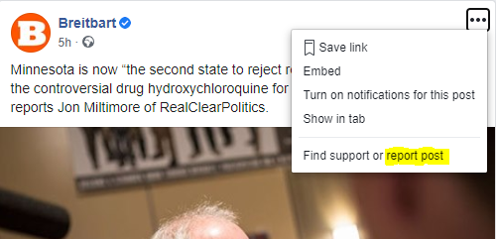
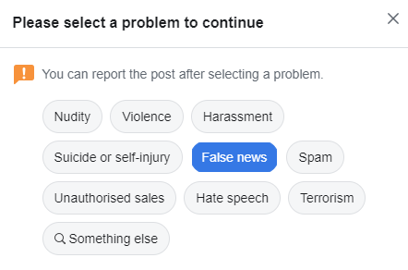

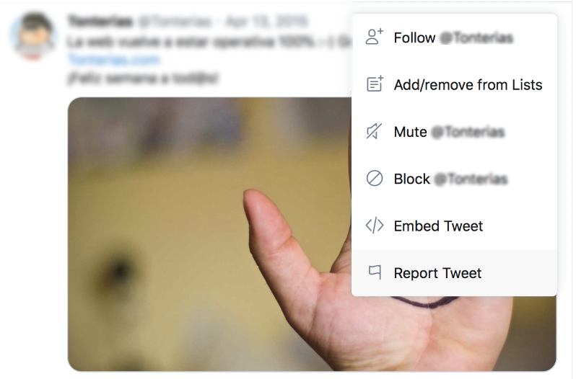
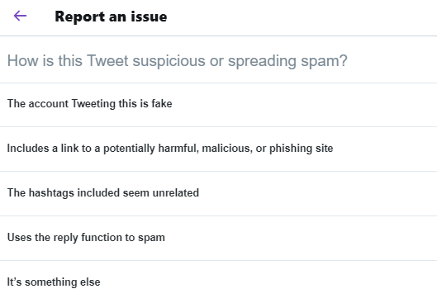

3
DER UMGANG MIT DESINFORMATION
Mach Meldung an
die Plattformen
Notes:
Different platforms have different policies for dealing with disinformation, misinformation and potentially harmful content. But you can help by proactively reporting stories and posts that seem suspicious to you (either because of their content, or because you think the account posting them might not belong to a real person, or the posting/commenting is happening in a coordinated and inauthentic manner). The platforms usually have a function for you to easily do this.
More info: https://www.who.int/campaigns/connecting-the-world-to-combat-coronavirus/how-to-report-misinformation-online?gclid=CjwKCAiA9bmABhBbEiwASb35Vz8fbkigZUcF5SG8wVuOlgHWspqsMm65mx_h1Eo7yRGJPGx8MtOlHhoCaQwQAvD_BwE
23

Slide 24

3
DER UMGANG MIT DESINFORMATION
HANDLE
NICHT VERSPOTTEN - ZEIGE EINFÜHLUNGSVERMÖGEN
Wir ALLE sind dafür verantwortlich, die Verbreitung von Unwahrheiten zu verhindern
Mit der Haltung
„Du liegst falsch und ich habe recht“
kommt man nicht weiter
Im Gespräch mit Freunden und Familie über Desinformation
ERWARTE NICHT, DASS SICH SOFORT ETWAS ÄNDERT
Nur mit hartnäckiger Höflichkeit bringt man andere dazu, Desinformation nicht weiterzuverbreiten
Notes:
How you fact-check your friends and family is important! It will often determine whether they listen to you or change their minds. Below is are some ideas on how to approach these difficult conversations.
- Biggest mistake you can make: While the temptation to insult people who believe misinformation is tempting, it is extremely counterproductive. Many of these people might have understandable, although misguided, concerns that apply to their specific situation, but not the population at large. For example, their child might have had a reaction to a vaccine because the doctors were unaware of an allergy, and they might mistrust vaccines because of it. Attacking them in such a case will only embolden their beliefs.
- Reach hard-liners by sharing their concerns: At the end of the day people who believe misinformation (such as vaccine deniers) are people too, who just want to make sure their children are safe. The evidence however indicates that vaccines are (at the very least) safer than staying unvaccinated. Explaining this in a companionate and empathetic way is the most likely way of getting people to change their minds; in other words, be patient and be nice to them.
- The scientific process is full of uncertainty and this is not communicated very well. Any information you provide needs to be accompanied by an honest explanation of the degree to which there is a scientific consensus or certainty. While this should not be the leading message when talking to friends and family, it should be included and accurately reflect the degree of uncertainty among experts. People need to understand that science is a process of trial error and that decisions are made based on the best information available at the time, which is subject to change as new studies are conducted.
If you want to learn more, read here:
https://firstdraftnews.org/latest/how-to-talk-to-family-and-friends-about-that-misleading-whatsapp-message/
https://www.poynter.org/fact-checking/2020/have-you-become-a-personal-fact-checker-to-your-family-and-friends/
24

Slide 25
4
GRUPPENARBEIT - AUFGABEN FÜR 3-4 GRUPPEN
Aufgaben für 3-4 Gruppen
TEILT EUCH IN GRUPPEN AUF
IHR ERHALTET DAS FALLBEISPIEL UND EURE AUFGABEN
BEREITET EINE PRÄSENTATION VOR

Slide 26

5
ZUSAMMENFASSUNG - TIPPS, WAS HABEN WIR GELERNT?
Was
ist Desinformation?
Wie
funktioniert Desinformation?
Wie
sollten wir mit Desinformation umgehen?
Tipps
Weiterführende Tipps

Slide 27


5
WEITERFÜHRENDE TIPPS - ONLINE-SPIELE ZUM THEMA DESINFORMATION (EXTERNE RESSOURCEN)
The Bad News Game (mehrere Sprachen) und Bad News Game for Kids (kleinere Sprachauswahl).
Erstelle eigene Fake News. Standardversion: ab 15 Jahren. Version für Kinder: ab 8 Jahren.
In mehreren Sprachen verfügbar.
Real or Photoshop? (EN) Teste deine Beobachtungsgabe und lerne verstehen, wie Bilder manipuliert werden können.
Nur auf Englisch verfügbar.
Fakescape (CZ und EN). Spielerisch lernen, wie man Fake News „entkommt“. Auf Anfrage und für Lehrpersonal kostenlos. Ab 13 Jahren.
Verfügbar auf Englisch und Tschechisch.
Fakey (EN). Spiel, das Medienkompetenz vermittelt und zeigt, wie Menschen mit Fehlinformationen umgehen. Ab 16 Jahren.
Nur auf Englisch verfügbar.
Escape Fake (DE und EN). Spiele-App zum Download, die spielerisch Medienkompetenz vermittelt. Ab 15 Jahren.
Verfügbar auf Englisch und Deutsch.
Troll Factory (EN). Der Spieler setzt als Troll Fake News in die Welt. Ab 16 Jahren.
Nur auf Englisch verfügbar.

Slide 28
5
WEITERFÜHRENDE TIPPS - FAKTENPRÜFER
Aktuelle Listen der Organisationen, die in deinem Land Fakten prüfen, führen das Poynter Institute
und Facebook
Ergebnisse des Faktenchecks zu einem Thema oder einer Person im Netz mit
Google’s Fact Check Explorer
‘Learn to Discern’ – Handbuch für Schulungsleiter im Bereich Medienkompetenz von IREX, einer gemeinnützigen Organisation
für globale Entwicklung und Bildung
EU-eigene Gruppe gegen Desinformation und Kampagne „Vor dem Teilen nachdenken“

Slide 29
5
WEITERFÜHRENDE TIPPS - NATIONALE RESSOURCEN
ÖSTERREICH
Mediamanual
Saferinternet
BUPP
Click & Check
BELGIEN
Mediawijs
BULGARIEN
Gramoten
KROATIEN
Vereinigung für Kommunikation und Medienkultur
Kinder der Medien
Medienkompetenztage
ZYPERN
Combating Misinformation Through Media Literacy
TSCHECHISCHE REPUBLIK
Clovekvtisni
Fakescape
Elpida
DÄNEMARK
International Media Support
TjekDet
DR Detektor
DR Ultra
Børneavisen
Danske Medier

Slide 30
5
WEITERGEHENDE EMPFEHLUNGEN - NATIONALE RESSOURCEN
ESTLAND
Meediapädevuse nädal
SALTO Participation & Information
FINNLAND
Medienkompetenz in Finnland
KAVI
Media Literacy School
Mediataitoviikko
Mediakasvastus
YLE Digitrennit
YLE Uutisluokka
FRANKREICH
IREX Europe
DEUTSCHLAND
Medienkompetenz stärken
SCHAU HIN! Was Dein Kind mit Medien macht
Gutes Aufwachsen mit Medien
Surfen ohne Risiko
App-Datenbank des Deutschen Jugendinstituts
ACT ON! aktiv + selbstbestimmt online
Kindersuchmaschine „Blinde Kuh“
DW Akademie
GRIECHENLAND
Media Literacy Institute
Fakescape

Slide 31
5
WEITERGEHENDE EMPFEHLUNGEN - NATIONALE RESSOURCEN
UNGARN
Televele
IRLAND
Be Media Smart
ITALIEN
Pagella Politica
Facta
Media Education
Eurispes
LETTLAND
Pilna doma (Full Thought)
Re:Check
CAPS un CIET jeb vilks manipulators
Medijpratējs
Superheroes in the Internet
LITAUEN
Draugiškas internetas (Friendly Internet)
Žinau viską
Media Literacy Platform
Debunk.eu
LUXEMBURG
Bee-secure
ΜΑLTA
BeSmartOnline!
NIEDERLANDE
Netwerk Mediawijsheid
Europäisches Zentrum für Journalismus
Hoezomediawijs
Bad News

Slide 32
5
WEITERGEHENDE EMPFEHLUNGEN - NATIONALE RESSOURCEN
POLEN
Stefan-Batory-Stiftung
Journalistic Craft for Neighborhood
Demagog
Center for Citizenship Education
Nowoczesna Polska
Kinder im Netz
Panoptykon-Stiftung
Polnische Gesellschaft für Medienkompetenz
Stiftung The School with Class
Wojownicy Klawiatury
Konkret 24
PORTUGAL
MILObs
Internet Segura
Nationale Initiative für digitale Kompetenz e.2030
RUMÄNIEN
ActiveWatch
Factual
Funky Citizens
Mediawise Society
SLOWAKEI
Council for Broadcasting and Retransmission

Slide 33
5
WEITERGEHENDE EMPFEHLUNGEN - NATIONALE RESSOURCEN
SLOWENIEN
NE/JA Razbijalka Mitov
MIPI – medijska in informacijska pismenost
Časoris
Otroci in mediji: iskanje resnice v svetu novic
Medijska pismenost
Safe
SCHWEDEN
MIK för mig
Schwedische Agentur für internationale Entwicklung
FOJO
SPANIEN
Instituto RTVE
Maldita
Internet Segura for Kids

