Slide 1




SPOT AND FIGHT
disinformation

Slide 2



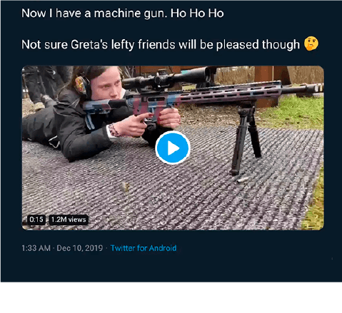

SOME EXAMPLES
SOMEONE ON TWITTER SAYS
SOMEONE ELSE ON FACEBOOKS POSTS
Greta holding a machine gun!
The Pope supports a political leader!
Notes:
Which one is fake?
Ice-breaker: Let’s start with an easy example that probably won’t fool anyone, but might make you laugh.
Source: www.snopes.com

Slide 3
SOME EXAMPLES
MISCAPTIONED
THE SOURCE DOES NOT EXIST
FALSE
FALSE
The picture belongs to the account of another girl who, from that particular angle, looks like Greta.
Dailypresser.com is not a real news website, the post was completely invented.
Notes:
Sometimes hard to tell the difference between true and false
Solutions: both fake
Deceptive story: a climate activist with a gun? The picture belongs to another person who, from that particular angle seems to be Greta Thunberg (Source: www.snopes.com and https://factual.afp.com/el-video-de-una-mujer-disparando-no-muestra-greta-thunberg-sino-una-ingeniera-sueca)
Invented news: The story is not true and the news source (dailypresser.com) simply does not exist

Slide 4





LESSON PLAN
  UNDERSTANDING DISINFORMATION
2
1
  WORK IN GROUPS
  CASE STUDIES
  SUMMARY & TIPS FOR FINDING OUT MORE
3
4
  PRESENTATIONS
  & DISCUSSIONS
Notes:
Understanding disinformation – slide 4-24
Work in group – slide 25
Presentation & Discussion slide 25
Summary & Tips for finding out more – slide 26-34

Slide 5


UNDERSTANDING DISINFORMATION
What
is disinformation?
How
Examples
does disinformation work?
Examples
How
should we respond to disinformation?
Recommended responses
Notes:
We will talk about definitions, techniques and offer some advice on how to easily spot disinformation, protect yourself from it and help others become more vigilant too!

Slide 6

WHAT IS DISINFORMATION
1
FOREIGN INTERFERENCE
INFLUENCE OPERATIONS
DIS-INFORMATION
MIS-INFORMATION
FACTS
OPINIONS
SATIRE & HUMOUR
WHAT IS FACT
WHAT IS FICTION
Notes:
WHAT IS DISINFOMATION
Learning objectives:
start with definitions and be able to distinguish between the concepts
assess the dangers of each case study and how it could be used as a disinformation narrative
stress importance of values: promotion of media freedom and pluralism, respect for fundamental rights like freedom of expression, no ‘Ministry of Truth’
Ask the pupils if they know what disinformation is. Check the pupils’ examples against the definition. Could some of them have been disinformation?
If not, what are they? (For instance, unpleasant news or opinions, marketing, mistakes or misunderstandings.)
Opinion or fact? Draw a distinction between opinion and fact.
What is a fact? Facts can be checked and backed up with evidence.
What is an opinion? Opinions are based on a belief or point of view, not on evidence that can be verified. Some people might think it is the opposite.
Suggested (optional) activity: Ask the students to go through a newspaper piece and highlight parts that are opinions, verify those that are facts with a reliable source, and the ones that seem like facts, but do not mention sources. Ask the class to share its findings.
False information is everywhere but it’s important to distinguish disinformation from other types of false information, namely misinformation, based on the INTENTION:
Disinformation is false information that’s created and shared to deliberately cause harm. Example: a tweet about migrants committing crimes in Europe, designed to divide society.
Misinformation is false information that’s shared by people who don’t realize it’s false and don’t mean any harm. Often they’re just trying to help. Example: when your aunt shares an article or meme on Facebook claiming that garlic protects from COVID-19 because she thinks it’s useful information without realizing it’s false.
Influence operations - coordinated efforts to influence a target audience using a range of illegitimate and deceptive means, in support of an adversary’s objectives
Foreign interference - coercive, deceptive, and/or clandestine efforts by a foreign state actor or its agents to disrupt the free formation and expression of political will, during elections, for example
Pupils might also be familiar with the term ‘fake news’, but we don’t recommend using it. When politicians blame independent journalists for publishing ‘fake news’ while they are simply being critical, something is wrong. We don’t want the term ‘fake news’ to result in delegitimizing the media.

Slide 7

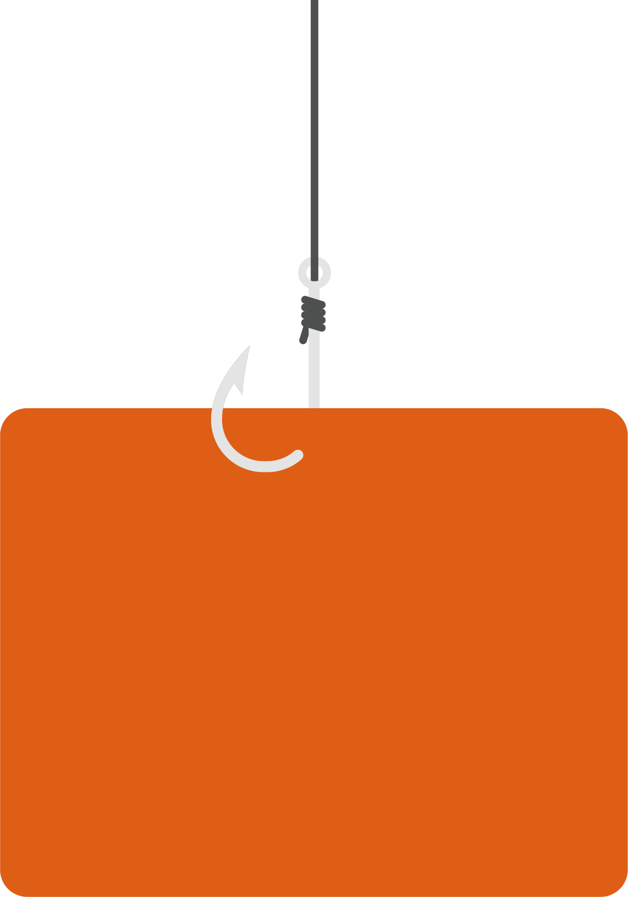
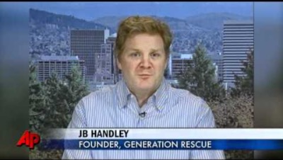
WHAT IS DISINFORMATION - THE ‘ANTI-VAX’ MOVEMENT
1
Fake conclusions, social illusion
Scapegoating, real causes of
autism are forgotten/not analysed
Long-term impact: decrease
in vaccination % means mass epidemic later
Notes:
Start by playing the video on the slide (https://www.youtube.com/watch?v=d8uRYqsu2W4)
Total time: 1 min 40 sec
Transcript:
---------------------------
(voiceover)
For millions of families dealing with autism it was a possible answer for their struggles. A landmark medical study, linking children’s vaccinations with the disorder. But that study is now being called 'misleading' with some even saying it’s an elaborate fraud.
(Fiona Godlee, Editor, British Medical Journal)
We’ve known from the start that the study was a poor study. It got an enormous amount of media attention. All of the evidence, all of the epidemiological studies, the ones looking at blood populations of children have countered this and said there is no evidence of the link.
(voiceover)
It was a paper by Andrew Wakefield and his colleagues in 1998 that scared patients prompting immunisation rates around the globe to drop. Wakefield claimed 12 children were normal until they got the common vaccine for measles, mumps, and rubella.
But his paper was later retracted, and a new examination found that Wakefield and his colleagues altered facts about patients in their studies. But Wakefield still has his supporters – Jamie Handley is one of them, he is the father of an autistic son.
(JB Handley, Founder, Generation Rescue)
Vaccines are known to cause brain injury, so it doesn’t take a rocket scientist to think: they took the kid for an appointment, they were normal, they came out, they were suffering dramatically. And these things cause brain injuries to some kids. That’s why we’re all still here and the real science has never been done.
(voiceover)
Wakefield was stripped of his right to practice medicine in Great Britain last May. Since then other studies have shown no connection between the MMR vaccination and autism.
Wakefield could not be reached for comment. Rosenson, the Associated Press.
---------------------
Speaking points:
Society requires people in academic institutions to follow high academic standards, so it is important to understand why those are necessary. This one single academic paper, which was disproven and debunked many times, is one of the biggest reasons the anti-vaccine movement was created and is still prevalent today. Even though the paper was wrong, it got enough media attention to damage the public perception of vaccines, which have repeatedly been shown to be safe and effective.
Everybody has a right to free speech, but is not the same as having the right to deliberately spread lies, especially when they can do damage to public health.
Why it’s bad:
People are eager “to quickly connect the dots” even when the connections they make contradict scientific insights.
Transferring guilt helps to obscure potential factors like individual responsibility or proven causes for the development of autism. For example, autism is usually diagnosed around the same time that the MMR vaccine (i.e. measles vaccine) is given to children. This fact is usually ignored by people who would rather believe their child was given autism than accept that the diagnosis was out of their control.
When spread broadly, this fake story risks becoming a game changer for the vaccination system. Large numbers of people could needlessly lose their immunity to serious diseases.

Slide 8


WHAT IS DISINFORMATION - THE STORY OF 5G CAUSING CORONAVIRUS
1
FREEDOM OF EXPRESSION
DAMAGE TO 5G TOWERS
CAUTIOUSNESS ABOUT
HEALTH EFFECTS
COMMUNICATION
NETWORKS FAIL
FALSE ASSOCIATION
OF COVID-19 WITH
NETWORK TECHNOLOGIES
Notes:
Since the beginning of the COVID-19 pandemic, much confusing information has spread on social media, with many claiming a link between 5G technologies and the spread of coronavirus. On the one hand, everyone has the right to express themselves freely, and it’s not bad to be cautious or even skeptical about new technologies and the effect they can have on our lives and health.
BUT this theory has brought harmful consequences in the real world, such as the burning down of telecommunications infrastructure, and physical attacks on workers installing the infrastructure.
Why it’s bad:
Real-life destruction: arsonists setting fire to cell towers across Europe
Failure of telecommunications networks, as many of the towers destroyed and vandalized were for 3G and 4G service, which the public depends on
Telecoms employees harassed on the street for laying down 5G fiberoptic cable or any other type of telecommunications infrastructure.
“When people feel threatened or out of control or they’re trying to explain a big significant event, they’re more vulnerable or prone to turning to conspiracy theories to explain them. Somewhat counterintuitively, it gives people more sense of control to imagine that, rather than random things happening, there are these shadowy groups and agencies that are controlling it. Randomness is very discomforting to people.” John Cook, expert on misinformation at George Mason University’s Center for Climate Change Communication

Slide 9

WHAT IS DISINFORMATION - DRINKING HOT WATER KILLS THE CORONAVIRUS
1
TAKES ATTENTION AWAY
FROM REAL WAYS
TO PROTECT YOURSELF
(hand-washing / or social distancing, facemask)
NO PHYSICAL HARM
CAUSED BY DRINKING
HOT WATER
FALSE SENSE OF PROTECTION
AGAINST THE CORONAVIRUS
USES PEOPLE’S FEAR AND
UNCERTAINTY TO SPREAD
UNSCIENTIFIC INFORMATION
Notes:
Talking points:
- Using inappropriate health advice can induce people to not get cured, or to underestimate or overestimate a certain illness. This image in the context of covid 19 is a good example. This is the original that some of you might have seen on social media or even on some of your WhatsApp conversations: https://factcheck.afp.com/gargling-warm-salt-water-or-vinegar-does-not-prevent-coronavirus-infection-health-experts-say
Why it’s bad:
In this case, telling people to drink hot water is not very dangerous, but what if the disinformation was about drinking a liquid that is actually very dangerous to us, like bleach?
In fact, a study in the American Journal of Tropical Medicine and Hygiene showed that disinformation and misinformation about the coronavirus has led to the deaths of at least 800 people and possibly more (as of August 2020), as well as the hospitalization of around 6,000. The study examined COVID-19 related rumours, stigmata and conspiracy narratives circulating online and their impact on public health.
Often this false information is spread unintentionally but in many other cases it is spread by sources trying to generate clicks from headlines and stories carefully crafted to attract attention (‘clickbait’ journalism e.g. “Scientists are saying that this ancient remedy could be the answer to curing cancer. Click here to read more!”) or even malicious actors trying to sow chaos, confusion and pollute the information environment with many, often conflicting, narratives.

Slide 10
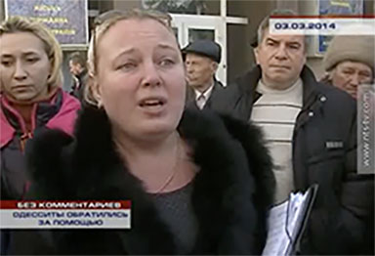
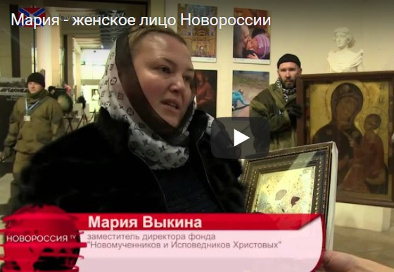
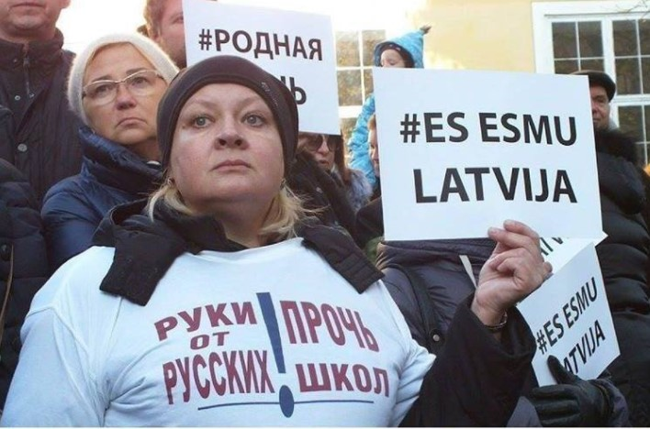
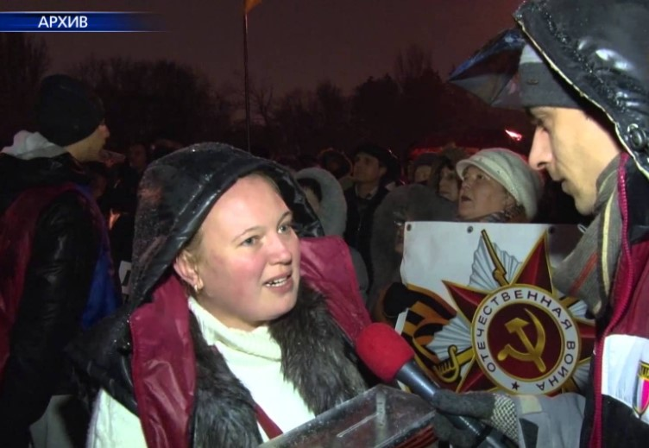
WHAT IS DISINFORMATION - THE SAME PERSON ACTS AS DIFFERENT ANTI-UKRAINIAN CITIZEN
1
I am Maria, a mother resident in Crimea
Now I am the vice chair
of a cultural foundation
in Lugansk
Now I am a russophone living in Riga, Latvia
Now I am living
in Kharkiv, Ukraine
REAL PERSON USED AS ACTRESS IN A FAKE STORY
Notes:
Start by playing the video on the slide (https://www.youtube.com/watch?v=9jnq3MRLsEU)
Total time: 40” (from 2min51sec to 3min31sec)
Transcript (translated):
---------------------------
(Maria, she calls herself an Odessa resident who came to the rally in Sevastopol, Crimea on March 3rd, 2014)
(the excerpt is from NTS – Crimean TV station broadcast as a report from the public rally)
//
Teachers from the school are calling and ask for protection.
My children learn at Russian school and I am on the parents’ board.
When I come to school and children ask “Will we too go to prison now for learning the Russian language and talking in Russian?”
In order to reach you we had to switch off our cell phones, took batteries out.
The huge persecution started – it is truly horrible.
---------------------------
//
Various videos with the same participants:
https://www.youtube.com/watch?v=Onui6ivzf4o (Kharkiv)
https://www.youtube.com/watch?v=9jnq3MRLsEU (Sevastopol)
https://www.youtube.com/watch?v=mYlDRUnzvsc (“referendum” in Crimea)
https://www.youtube.com/watch?v=3YM-Og-g_jY (Kyiv)
https://www.youtube.com/watch?v=x4jWXVQ-Jog (Lugansk) > video unavailable
https://www.youtube.com/watch?v=JzcBu28nqV0 (Krivoy Rog)
Speaking points:
- Propaganda authors must be sure that their message is consistent, so professional actors are used to impersonate various emotionally moving characters
- Using real examples would not appear that radical, so the arguments would be balanced and the final impact for the viewer would be objective. Instead, here we have manufactured hatred against the cause of Ukrainian independence and its supporters
Why it’s bad:
Fake information is used to vilify opponents, no matter what the facts on the ground are.
An extreme (false) description of the situation is portrayed as real and so incites a vengeful response
Emotional manipulation uses various social groups as an indirect argument for supporting “extreme counter-measures”

Slide 11


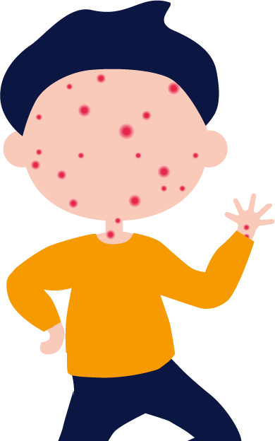
HOW DISINFORMATION WORKS - DISINFORMATION PROCESS I
2
BELIEVE
SUPPORT
ACT
Notes:
HOW DISINFOMATION WORKS
Learning objectives
Understand the main actors, behaviours and content that define disinformation
Understand that those who spread disinformation often try to intentionally evoke emotional responses from readers
Understand that we are all at risk from disinformation; discuss the reasons why it’s dangerous.
Descriptions:
- When do we start believing something and when are we ready to go an extra mile to support something?
- Disinformation is a process - It does not happen quickly:
- Fake research report linking measles vaccine with autism was published in 1998 → Fake research fuels fears against vaccination, which results in increase of the measles disease
- Motivation to support an idea/cause for political or financial gain
- Students are encouraged to reflect how no real debate can happen unless everyone can make informed choices based on facts; while all opinions are acceptable, spreading lies is not.

Slide 12








HOW DISINFORMATION WORKS - DISINFORMATION PROCESS II – EUROPEAN VALUES
2
EUROPEAN VALUES
UNITY IN
DIVERSITY
Notes:
Speaking points:
Exaggerating differences is a tool for weakening a community
It is more difficult to undermine a strong community that unites behind its shared values and its common identity

Slide 13
HOW DISINFORMATION WORKS - DISINFORMATION PROCESS II – EUROPEAN VALUES
2
Mistrust and
suspicion grow
Trust in values like democracy and equality slowly fade out
EUROPEAN VALUES
UNITY IN
DIVERSITY
Notes:
Therefore disinformation is used to divide people and exaggerate internal differences
Providers of disinformation want to polarize our societies and promote “us vs them” narratives
When former friends are divided, it is much easier to fight each small group separately
But much of the progress in civilisation lies in finding compromises between the interests of different groups

Slide 14
HOW DISINFORMATION WORKS - DISINFORMATION PROCESS II – EUROPEAN VALUES
2
CONFUSION AND INDECISION REIGN
ANTI EUROPEAN VALUES GROW
EUROPEAN VALUES
UNITY IN
DIVERSITY
Notes:
We are all at risk of falling prey to disinformation. It is a dangerous phenomenon that can:
- spread mistrust in public institutions, which can lead to political apathy or radicalization.
- spread mistrust in scientific and medical information, which can have serious health consequences.

Slide 15
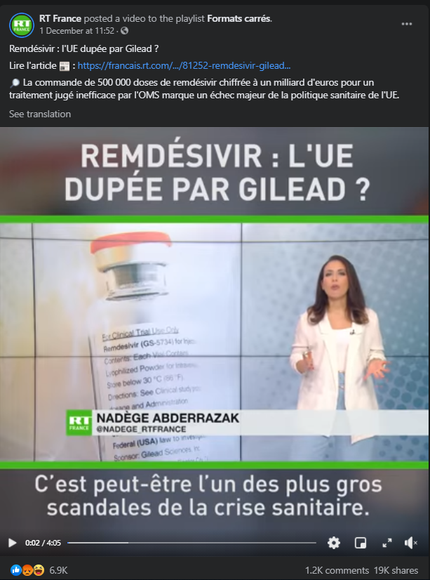
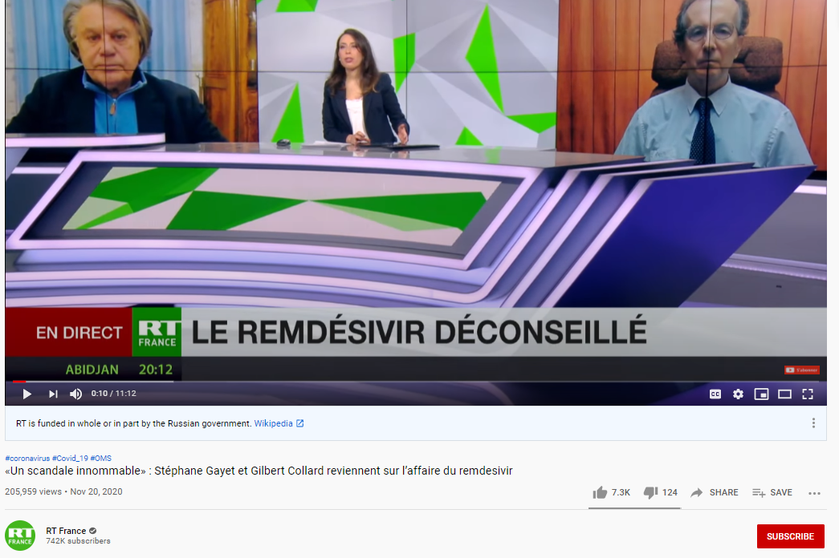
HOW DISINFORMATION WORKS - DISINFORMATION PROCESS II - AGAINST THE EU: FROM RUSSIA TODAY
2
Notes:
State-controlled media like Russia Today are ‘usual suspects’ among the purveyors of disinformation, especially with the aim of sowing distrust and creating division within the EU and the West. A common tactic of actors who spread disinformation, specifically those linked to the Kremlin, is to sow distrust in democratic institutions and seek to undermine the European Union by deliberately crowding the information space with false narratives. In the examples here, the coverage by Russia Today centers on Remdesivir, which was authorised in the EU in July 2020 for the treatment of COVID-19 in adults and adolescents from 12 years of age with pneumonia who require supplemental oxygen. Pro-Kremlin media have promoted multiple deceptive stories on the EU buying large stock of Remdesivir, which was allegedly deemed as an ineffective treatment by the WHO. The stories described this move as a major failure of EU health policy and “of the greatest scandals of the health crisis”. In reality, according to WHO, the certainty for their results is low and the evidence did not prove that Remdesivir has no benefit. The recommendation is conditional, which is issued when evidence around the benefits and risks of an intervention are less certain.
This is a widely used method by malign actors who spread disinformation for political and financial gain: the goal is more often than not to undermine the EU/the West by presenting its policies and values as failed ones, therefore eroding the public’s trust in institutions and authorities involved in those decisions. By amplifying information like the story above, disinformation actors create more confusion during an already uncertain situation, leading the public to often ignore the guidance of national authorities and scientific experts.
Source: https://www.youtube.com/watch?v=e7jiPDxxx3o&ab_channel=RTFrance
https://www.who.int/news-room/feature-stories/detail/who-recommends-against-the-use-of-remdesivir-in-covid-19-patients
https://www.ema.europa.eu/en/news/update-remdesivir-ema-will-evaluate-new-data-solidarity-trial

Slide 16
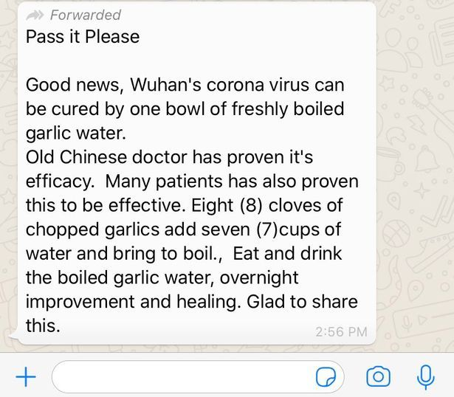
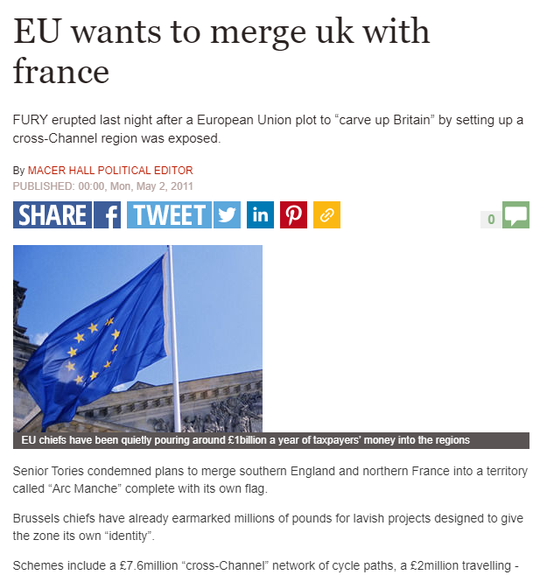
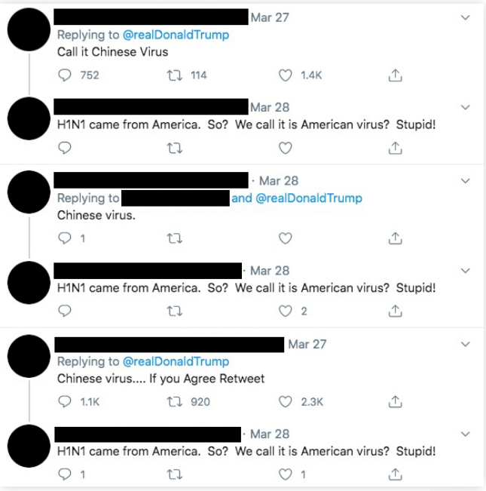
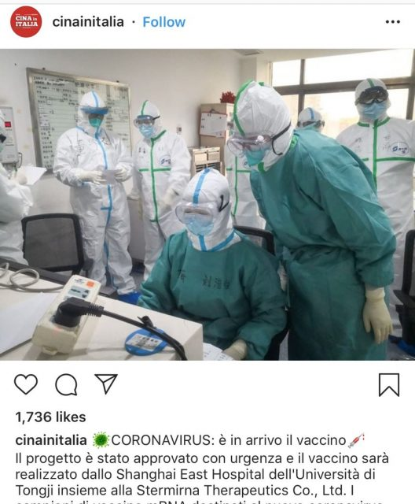
HOW DISINFORMATION WORKS - DISINFORMATION PROCESS II – EUROPEAN VALUES
2
Notes:
Whether the objective of those spreading a specific disinformation narrative is political or financial gain, social media plays a tremendous role in amplifying or stopping disinformation from spreading. Speak about:
Social media is used by everyone, including us and everyone we trust, like our friends and family. That’s why we have to be extra vigilant with information we see/receive. See above an example of a WhatsApp message containing entirely false information on a bogus coronavirus cure. (left)
Clickbait (generating profit from clicks) > making headlines or images/videos intentionally appealing and mysterious to get more clicks. Remember the ‘Pope endorsing Trump’ article from earlier? See also example above of EU allegedly wanting to merge UK with France. (middle – top)
Completely fabricated stories like the one above of an Instagram post from April 2020 claiming to have found the vaccine for coronavirus, while no such vaccine existed at the time and no advanced research for it had began (middle – bottom)
Artificial amplification > getting a story or a narrative to go viral through inauthentic means: fake profiles and bots, storming posts with comments and shares to give it more traction. Profiles created to intentionally look like ‘everyday’ people with descriptions about normal jobs and hobbies but operated entirely artificially or by troll factories. The example above shows replies to different Twitter accounts’ posts, using similar narratives or identical text, which suggests coordinated messaging. Source: Report by Institute for Strategic Dialogue and Alliance for Securing Democracy - https://www.isdglobal.org/wp-content/uploads/2020/08/ISDG-proCCP.pdf
Out of context use of imagery: we’ll see an example in the next slides. A very common disinformation technique is to re-use older footage (often graphic or shocking) for a current event, or in entirely different contexts.
More info: https://www.cits.ucsb.edu/fake-news/spread

Slide 17

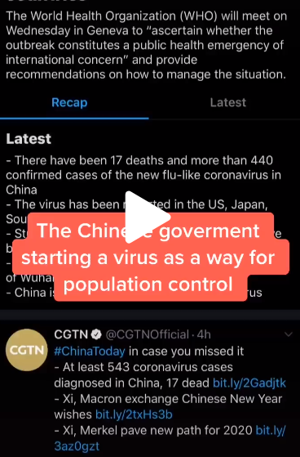
HOW DISINFORMATION WORKS - THE ROLE OF SOCIAL MEDIA
2
THE ROLE OF SOCIAL MEDIA
Notes:
TikTok, the short-video app, has seen an incredibly rapid increase in its base of users especially among teenage audiences. But as its popularity grew in Europe and in the United States, TikTok also became host to a wide range of false content, much of it political, as well as anti-vaccination posts and misinformation surrounding climate change, such as attacks on Swedish environmental activist Greta Thunberg.
Earlier this year, there were multiple videos on TikTok spreading baseless claims and debunked conspiracy theories about the coronavirus outbreak.
Videos like the one pictured here, with thousands of combined views made claims that “the Chinese government” was “starting a virus as a way for population control” or claiming the outbreak was “really a government biochemical attack” to distract people. Another video said that “people are convinced that China decided to release the virus by ‘accident’ ... as a way of controlling population.”
Since then, TikTok has developed clear guidelines against misleading information on their platform, including medical misinformation, but anyone who uses the app knows how quickly new trends, hashtags, challenges can start and spread so it’s important to be vigilant when viewing and sharing that content.
Sources: https://www.poynter.org/fact-checking/2019/misinformation-makes-its-way-to-tiktok/
https://www.mediamatters.org/fake-news/tiktok-hosting-videos-spreading-misinformation-about-coronavirus-despite-platforms-new

Slide 18
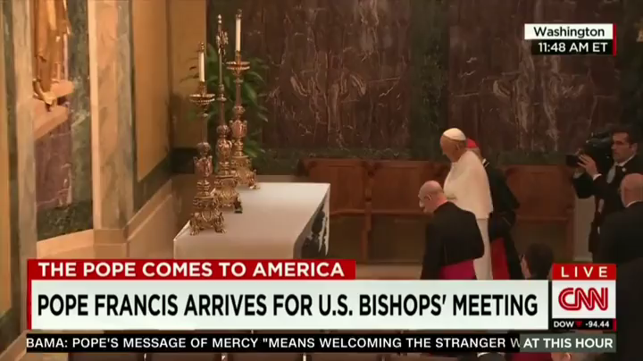
HOW DISINFORMATION WORKS - HOW CAN CONTENT BE MANIPULATED?
2
Notes:
Watch this video very closely – it looks very real, right? Unsurprisingly though, the Pope did not perform a tablecloth trick when visiting the United States and this clip is entirely fabricated: it’s what we call a ‘deep fake’. Here is a comparison with the original version: https://www.youtube.com/watch?v=ABy_1sL-R3s&feature=emb_title
Deep fakes are today’s version of Photoshop: they use artificial intelligence to create new footage (images, videos, voice recordings) that depicts events, statements or action that never actually happened. The results can be quite convincing. Deepfakes differ from other forms of false information by being very difficult to identify as false. Deepfakes are fake videos created using digital software, machine learning and face swapping.
For more information, please read here: https://www.betterinternetforkids.eu/web/portal/practice/awareness/detail?articleId=5398982#:~:text=Deepfakes%20are%20computer%2Dcreated%20artificial,action%20that%20never%20actually%20happened.&text=Deepfakes%20are%20fake%20videos%20created,machine%20learning%20and%20face%20swapping.

Slide 19

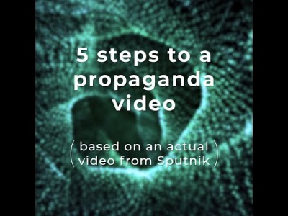
HOW DISINFORMATION WORKS - HOW CAN CONTENT BE MANIPULATED?
2
Notes:
Another example of using imagery out of context to construct a false narrative is this Sputnik story about children in ‘militarized’ Latvia getting indoctrinated by NATO: https://www.youtube.com/watch?v=nOd2vMCDv9M&feature=youtu.be
Let students reflect about their emotions. What do they feel when they see this? How would they react if this appeared in their news feed on Instagram/Tiktok? Why do they feel emotional about this? The news in itself, the way it is formulated, the picture…?
Introduce the next chapter: responding to disinformation

Slide 20




HOW TO RESPOND TO DISINFORMATION
3
Think
Report
Before you share
To the platforms
Become a personal fact-checker for your
Fact-check
family & friends
Notes:
HOW TO RESPOND TO DISINFORMATION
Learning objectives:
Understand that we all have a role to play in stopping disinformation from spreading, because it puts our democracies (and potentially our lives) at risk
Discuss the different steps for assessing the veracity of content, including being thoughtful before sharing and key elements in the process of fact-checking
Learn how to talk to others about disinformation and its dangers, and stop them perpetuating harmful and false narratives

Slide 21

HOW TO RESPOND TO DISINFORMATION - THINK BEFORE YOU SHARE & FACT-CHECK YOU SHARE
3
Doubt
Fact-check
Decide
Notes:
Descriptions:
Being aware of disinformation and the fact that you can be a target is a first step towards protection.
Fact-checking is a good 2nd step and can also be fun: it’s like playing detective and the pupils could really enjoy it. It’s true that, most of the time, it is quite time-consuming, but the students shouldn’t feel discouraged because often particular features of a piece of information already reveal a lot about the quality of the message conveyed.
You should always look at information with a critical attitude.
How to foster trust towards institutions and the media?
What would happen if, in time of crisis, we did not believe what our authorities tell us to do?
What’s important is the source - it’s good to maintain a certain level of skepticism, but it’s especially important if the source is not a reliable one.

Slide 22

HOW TO RESPOND TO DISINFORMATION - FACT-CHECK
3
Fact-checking when in doubt
Check the content
Join the myth-busters
Check the outlet
Question your own biases
Check the author
Think before you share
Check the sources
Check the pictures
Notes:
As an exercise, go back to one of the previous examples (e.g. video of children allegedly being given guns and joining the army in Latvia, or fake image of COVID-19 vaccine being invented).
Let the pupils reflect about their own bias. Do they feel this news confirms what they already believe? Would it have made a difference if this news was shared by a friend they like/ celebrities they follow…? Discuss how they can check if this is true (the steps of the compass): check the content/ outlet/ author/ sources/ pictures/ myth busters. Let them reflect on what is a trusted source and what not. THINK BEFORE YOU SHARE!! Show video of EUvsDisinfo as inspiration: https://www.facebook.com/watch/?v=3192621760756370; https://www.facebook.com/watch/?v=2584252091848910
In more detail:
Read the whole article – do the content and headline match?
How can I verify the reliability of a website? URL analysis: always check if it is the original website or if the URL is built with a slight modification in the name or extension, with the idea that a distracted or hasty reader would not notice. Disinformation sites take the names of well-known news sources, changing small details. For example: (from the slide at the beginning) dailypresser.com, or nevvyorktimes.com.
Check the date and author: public figures on social media often (but not always) have their accounts “verified”, as well as media and journalists. Often people working in the information industry have websites or other public profiles that can help you find them and their work.
Search for the story on the internet – do other sources support what is claimed? Do you know what kind of sources they are?
Check if pictures look strange or doctored. If so, you can do a reverse search on Google images: https://support.google.com/websearch/answer/1325808?co=GENIE.Platform%3DAndroid&hl=en. You might find out that it’s from a different event or an earlier date.
Think about the context around the information: imagine that a phone manufacturer tells you that sales have doubled. Now add context: It was December, holiday season, a lot of discounts are going on in stores and buying a phone is simply a little cheaper. This was to be expected, right? The same happens often also in public debates about political issues.

Slide 23
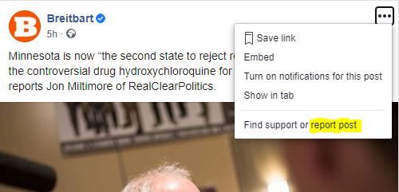
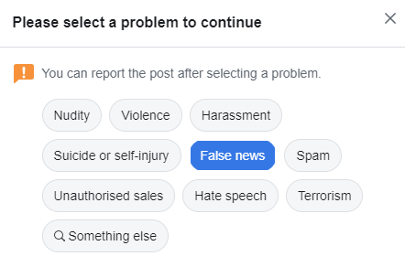

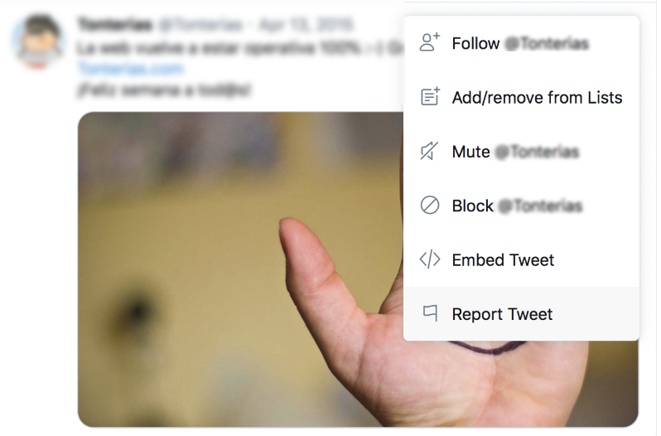
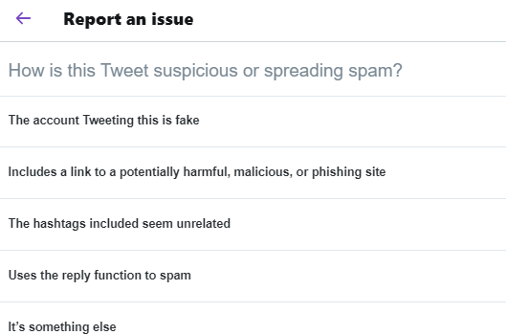

HOW TO RESPOND TO DISINFORMATION
3
Report
To the platforms
Notes:
Different platforms have different policies for dealing with disinformation, misinformation and potentially harmful content. But you can help by proactively reporting stories and posts that seem suspicious to you (either because of their content, or because you think the account posting them might not belong to a real person, or the posting/commenting is happening in a coordinated and inauthentic manner). The platforms usually have a function for you to easily do this.
More info: https://www.who.int/campaigns/connecting-the-world-to-combat-coronavirus/how-to-report-misinformation-online?gclid=CjwKCAiA9bmABhBbEiwASb35Vz8fbkigZUcF5SG8wVuOlgHWspqsMm65mx_h1Eo7yRGJPGx8MtOlHhoCaQwQAvD_BwE

Slide 24

HOW TO RESPOND TO DISINFORMATION
3
BE ACTIVE
DON’T SHAME
SHOW EMPATHY
We ALL have a responsability to hinder the spread of misleading information
Taking a tone of
“you’re wrong and I’m right”
does not work
How to talk about disinformation to friends and family
DON’T EXPECT IMMEDIATE CHANGE
It takes courtesy and patience to stop people spreading disinformation
Notes:
How you fact-check your friends and family is important! It will often determine whether they listen to you or change their minds. Below is are some ideas on how to approach these difficult conversations.
- Biggest mistake you can make: While the temptation to insult people who believe misinformation is tempting, it is extremely counterproductive. Many of these people might have understandable, although misguided, concerns that apply to their specific situation, but not the population at large. For example, their child might have had a reaction to a vaccine because the doctors were unaware of an allergy, and they might mistrust vaccines because of it. Attacking them in such a case will only embolden their beliefs.
- Reach hard-liners by sharing their concerns: At the end of the day people who believe misinformation (such as vaccine deniers) are people too, who just want to make sure their children are safe. The evidence however indicates that vaccines are (at the very least) safer than staying unvaccinated. Explaining this in a companionate and empathetic way is the most likely way of getting people to change their minds; in other words, be patient and be nice to them.
- The scientific process is full of uncertainty and this is not communicated very well. Any information you provide needs to be accompanied by an honest explanation of the degree to which there is a scientific consensus or certainty. While this should not be the leading message when talking to friends and family, it should be included and accurately reflect the degree of uncertainty among experts. People need to understand that science is a process of trial error and that decisions are made based on the best information available at the time, which is subject to change as new studies are conducted.
If you want to learn more, read here:
https://firstdraftnews.org/latest/how-to-talk-to-family-and-friends-about-that-misleading-whatsapp-message/
https://www.poynter.org/fact-checking/2020/have-you-become-a-personal-fact-checker-to-your-family-and-friends/

Slide 25
WORK IN GROUPS - TASKS FOR 3-4 GROUPS
4
Tasks for 3-4 groups
SPLIT INTO GROUPS
GET YOUR CASE STUDY & TASKS
PREPARE A PRESENTATION

Slide 26

SUMMARY - TIPS WHAT HAVE WE LEARNED?
5
What
is disinformation?
How
does disinformation work?
How
should we respond to disinformation?
Tips
for finding out more

Slide 27


TIPS FOR FINDING OUT MORE - ONLINE GAMES ON DISINFORMATION (EXTERNAL RESOURCES)
5
The Bad News Game (several languages) and Bad News Game for Kids (fewer languages).
Create your own fake news. Standard version: ages 15 and up. Kids’ version: ages 8 and up.
  Available in several languages.
Real or Photoshop? (EN) Test your powers of observation to better grasp image manipulation.
  Available in English only.
Fakescape (CZ and EN). Games that teach students how to “escape” fake news. On demand and free for lecturers. Ages 13 and up.
  Available in English and Czech.
Fakey (EN). Game that teaches media literacy and how people interact with misinformation. Ages 16 and up.
  Available in English only.
Escape Fake (DE and EN). Downloadable game app that playfully teaches media literacy. Ages 15 and up.
Available in English and German.
Troll Factory (EN). Player is a troll who creates fake news. Ages 16 and up.
  Available in English only.

Slide 28
TIPS FOR FINDING OUT MORE - FACT-CHECKERS
5
Lists of fact-checking organisations in your country are updated through the Poynter Institute
and Facebook
Search fact check results from the web about a topic or person with
Google’s Fact Check Explorer
‘Learn to Discern’ – Media Literacy Trainer’s Manual from global development and education
non-profit IREX
EU’s own anti-disinformation group and “Think Before you Share” campaign

Slide 29
TIPS FOR FINDING OUT MORE - NATIONAL RESOURCES
5
AUSTRIA
Mediamanual
Saferinternet
BUPP
Click & Check
BELGIUM
Mediawijs
BULGARIA
Gramoten
CROATIA
Association for communication and media culture
Children of the media
Media Literacy Days
CYPRUS
Combating Misinformation Through Media Literacy
CZECH REPUBLIC
Clovekvtisni
Fakescape
Elpida
DENMARK
International Media Support
TjekDet
DR Detektor
DR Ultra
Børneavisen
Danske Medier

Slide 30
RECOMMENDATIONS FOR FURTHER INTEREST - NATIONAL RESOURCES
5
ESTONIA
Meediapädevuse nädal
SALTO Participation & Information
FINLAND
Media Literacy in Finland
KAVI
Media Literacy School
Mediataitoviikko
Mediakasvastus
YLE Digitrennit
YLE Uutisluokka
FRANCE
IREX Europe
GERMANY
Medienkompetenz stärken
SCHAU HIN! Was Dein Kind mit Medien macht
Gutes Aufwachsen mit Medien
Surfen ohne Risiko
App-Datenbank des Deutschen Jugendinstituts
ACT ON! aktiv + selbstbestimmt online
Kindersuchmaschine "Blinde Kuh“
DW Akademie
GREECE
Media Literacy Institute
Fakescape

Slide 31
RECOMMENDATIONS FOR FURTHER INTEREST - NATIONAL RESOURCES
5
HUNGARY
Televele
IRELAND
Be Media Smart
ITALY
Pagella Politica
Facta
Media Education
Eurispes
LATVIA
Pilna doma (Full Thought)
Re:Check
CAPS un CIET jeb vilks manipulators
Medijpratējs
Superheroes in the Internet
LITHUANIA
Draugiškas internetas (Friendly Internet)
Žinau viską
Media literacy platform
Debunk.eu
LUXEMBOURG
Bee-secure
MALTA
BeSmartOnline!
NETHERLANDS
Netwerk Mediawijsheid
European Journalism Centre
Hoezomediawijs
Bad News

Slide 32
RECOMMENDATIONS FOR FURTHER INTEREST - NATIONAL RESOURCES
5
POLAND
Stefan Batory Foundation
Journalistic Craft for Neighborhood
Demagog
Center for Citizenship Education
Nowoczesna Polska
A Kid in the Web
Panoptykon Foundation
Polish Association of Media Literacy
The School with Class Foundation
Wojownicy Klawiatury
Konkret 24
PORTUGAL
MILObs
Internet Segura
National Digital Competence Initiative e.2030
ROMANIA
ActiveWatch
Factual
Funky Citizens
Mediawise Society
SLOVAKIA
Council for Broadcasting and Retransmission

Slide 33
RECOMMENDATIONS FOR FURTHER INTEREST - NATIONAL RESOURCES
5
SLOVENIA
NE/JA Razbijalka Mitov
MIPI – medijska in informacijska pismenost
Časoris
Otroci in mediji: iskanje resnice v svetu novic
Medijska pismenost
Safe
SWEDEN
MIK för mig
Swedish International Development Agency
FOJO
SPAIN
Istituto RTVE
Maldita
Internet Segura for Kids

